Slide 1

Did You Know?
Facts About Your Teeth!
Notes:
The health of your mouth is important to the health of your body, and today I am going to talk to you about taking care of your teeth!

Slide 2
Sharks Keep Growing New Teeth …
Notes:
There are animals like sharks who keep growing teeth as they fall out. Shark teeth are popularly found as beach treasures because sharks shed 1000s of teeth in a lifetime – usually at least 1 per week!

Slide 3
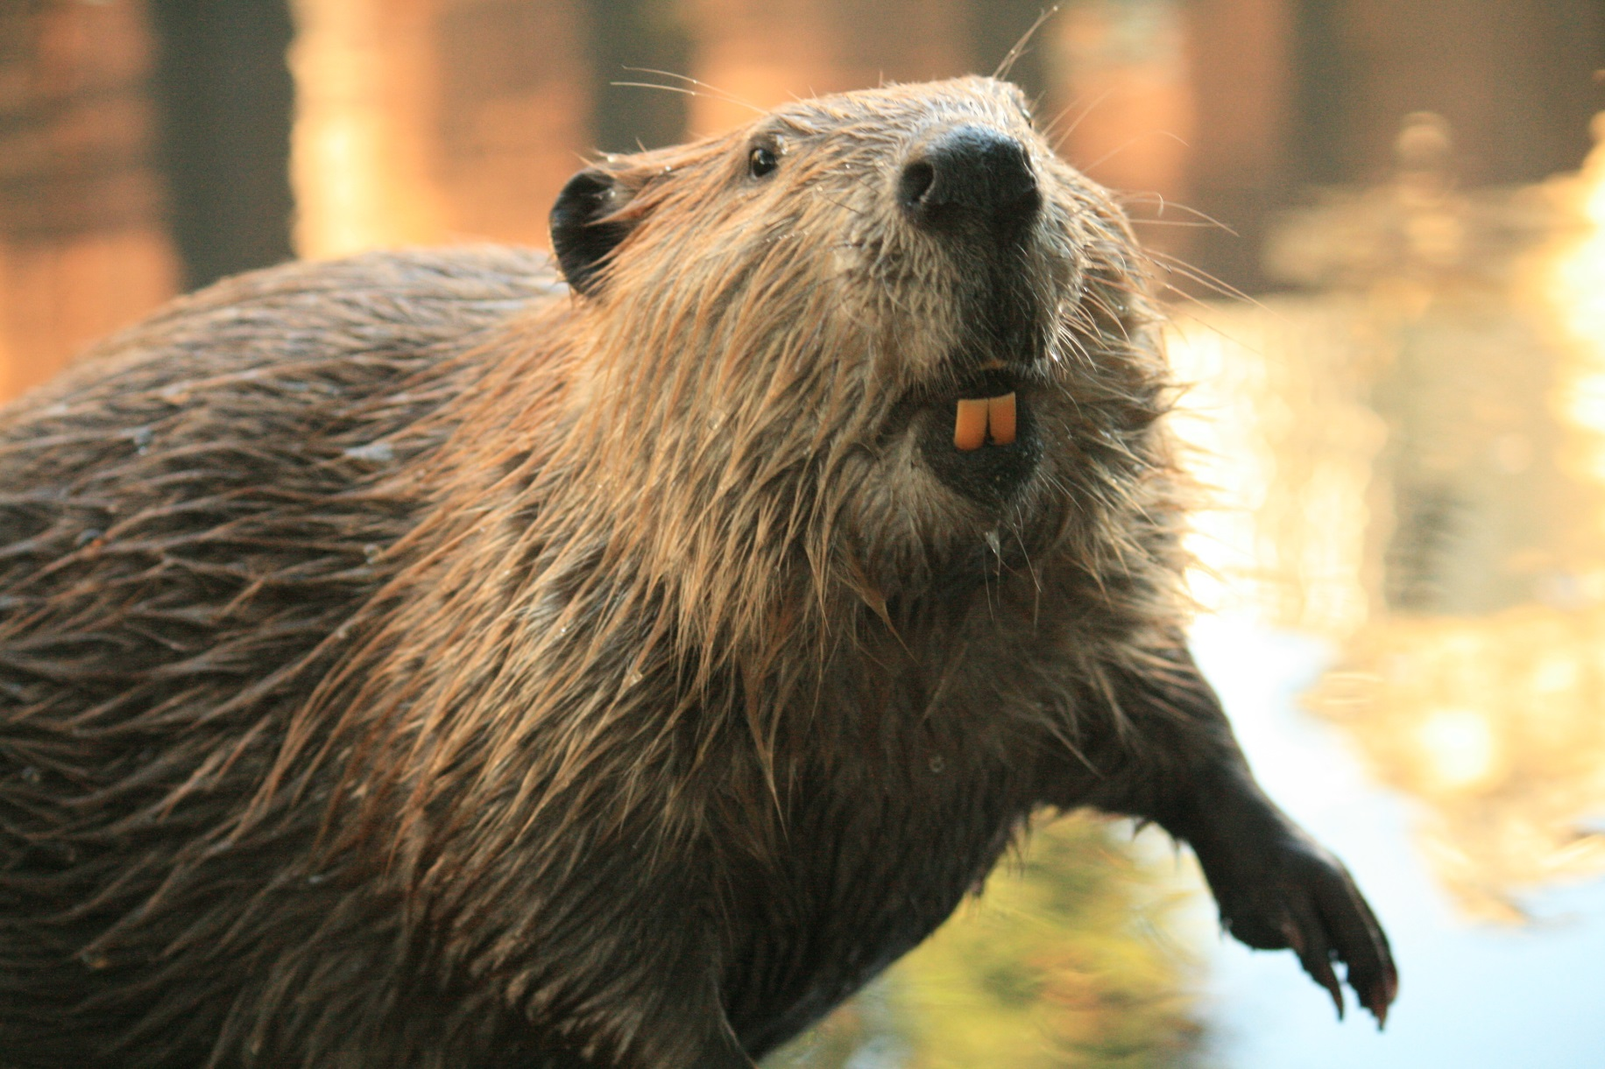
Beavers Get 1 Set that Grows Longer!
Notes:
And in the beaver, incisors grow their entire lives, but are worn down by grinding them together, tree cutting and feeding.

Slide 4
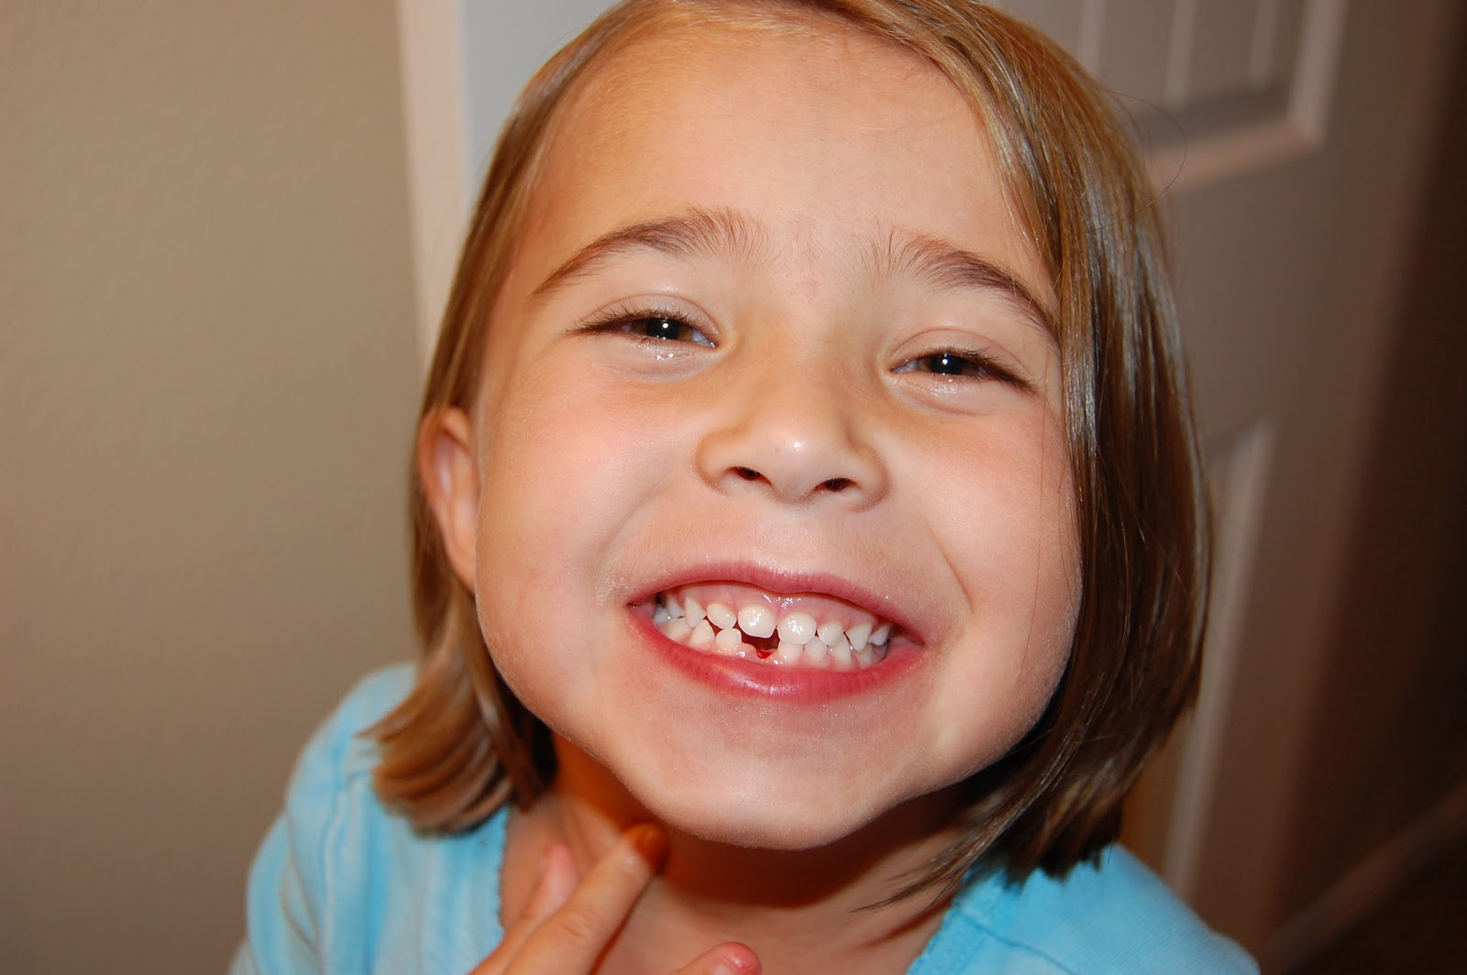
But Humans Only Get Two Sets!
Baby
Teeth
Permanent Teeth
Notes:
But not humans! How many sets of teeth do you think we get? (2)
When you are a baby and get your first teeth in your mouth, how many do you get? (20)
When you become an adult, how many teeth do you get in your mouth? (32)

Slide 5


We want to keep our teeth HEALTHY
& STRONG for our entire lifetimes!
Notes:
Why Do You Think Teeth Are Important?
Help Us Eat
Help Us Speak
Help Us SMILE!
Overall keep us healthy by having a clean, cavity free mouth.

Slide 6
“NOT So Good for You”
Drinks & Treats
Notes:
But some things we eat and drink that can really harm our teeth! We’re going to learn about these now and how you can make better choices.
How many of you like these kinds of drinks and treats (that will be shown on the following slides; move quickly through these slides – kids will usually cheer to show just how much they love something that is shown)
Discuss why these foods aren’t the best choices for your teeth … and that overall they aren’t the best choices for your body.

Slide 7
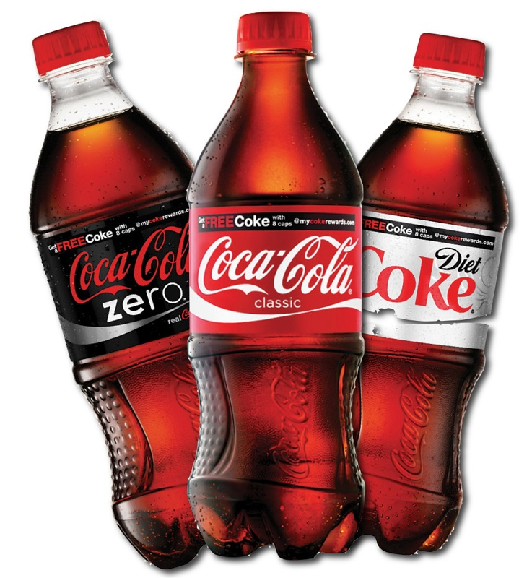

Slide 8
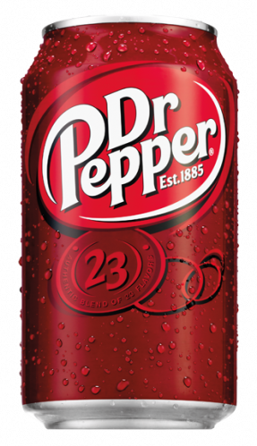

Slide 9
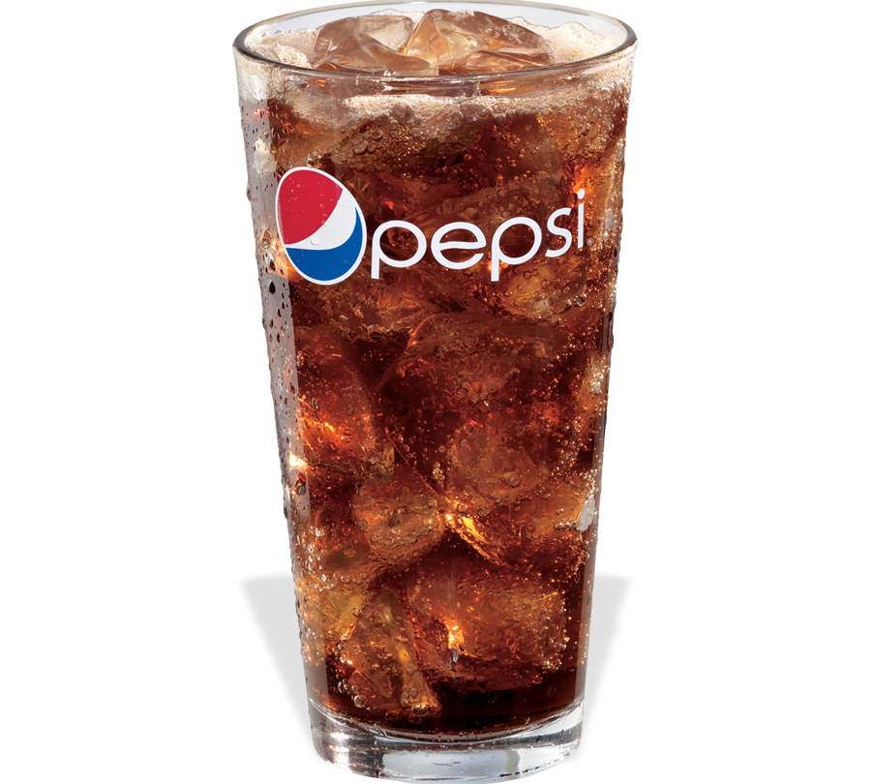

Slide 10
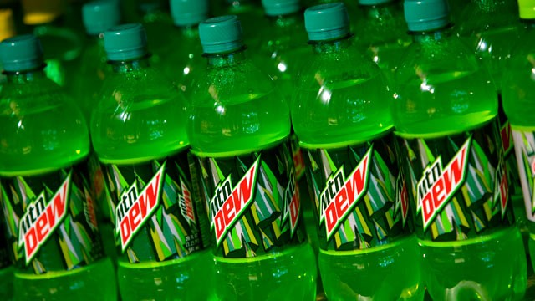

Slide 11
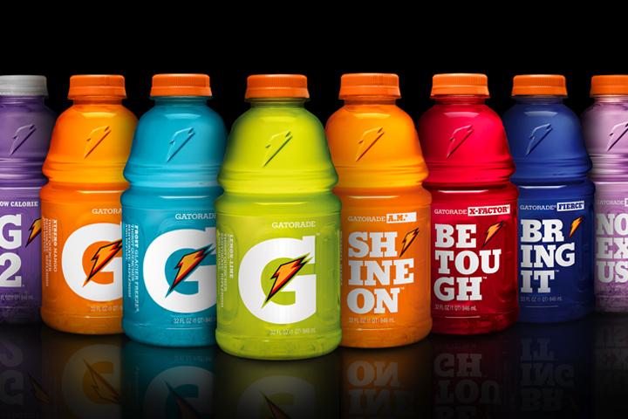

Slide 12
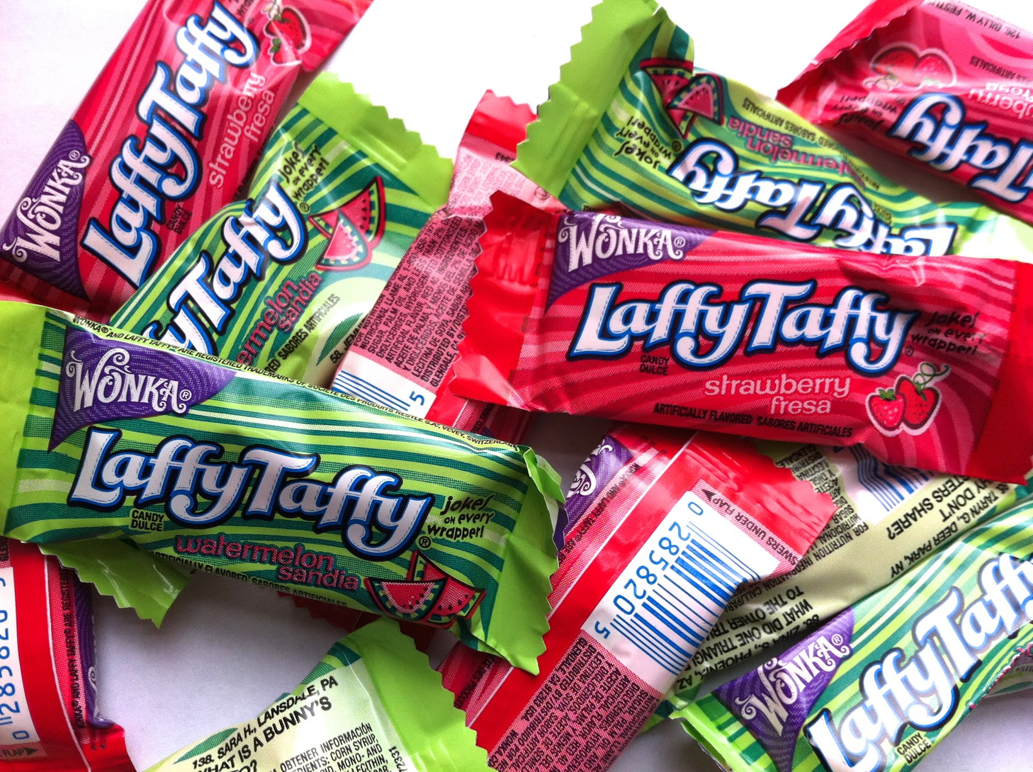

Slide 13
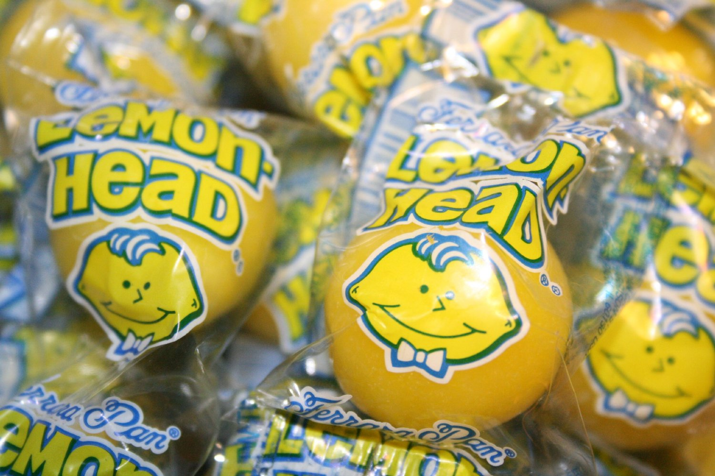

Slide 14
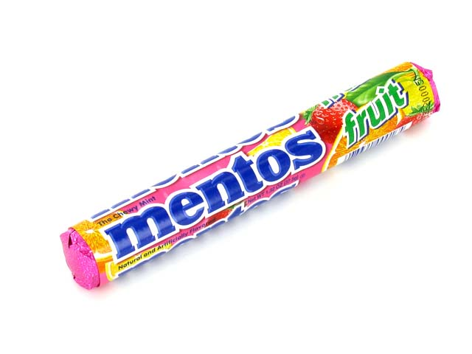

Slide 15
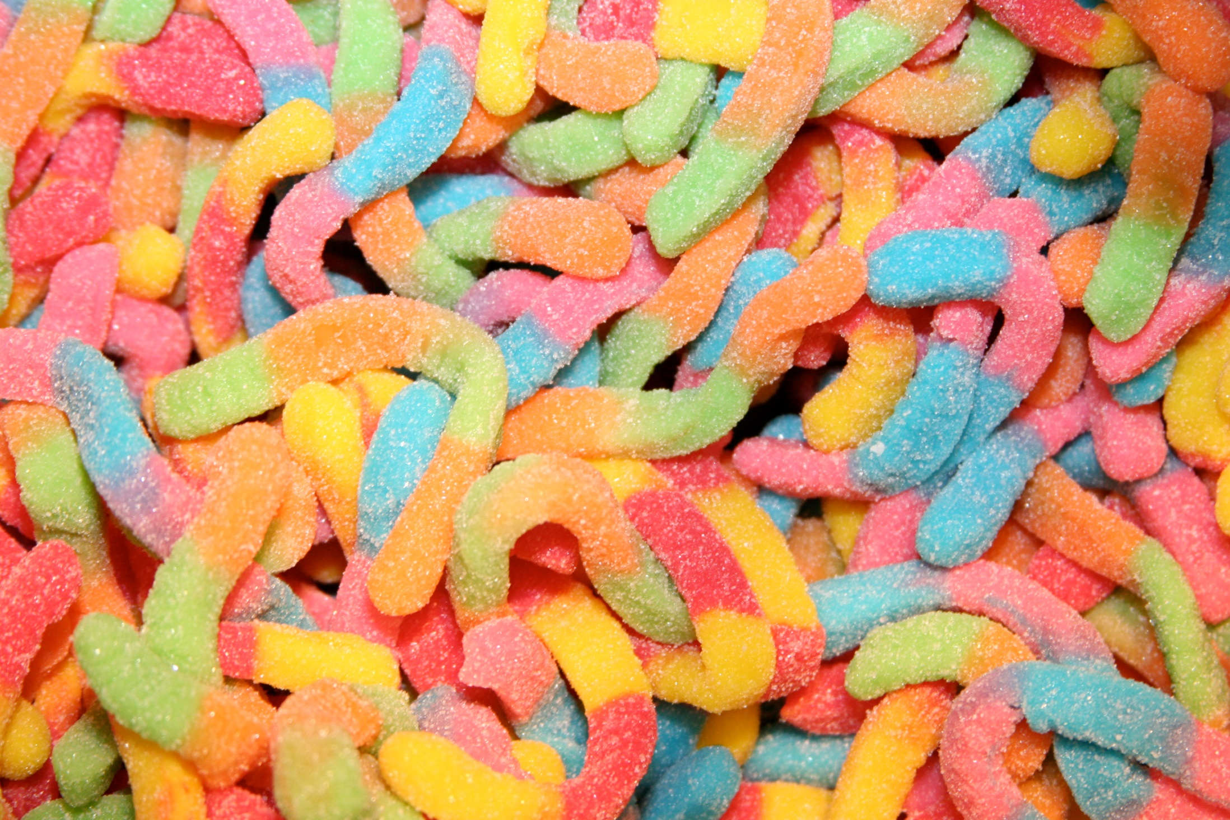

Slide 16
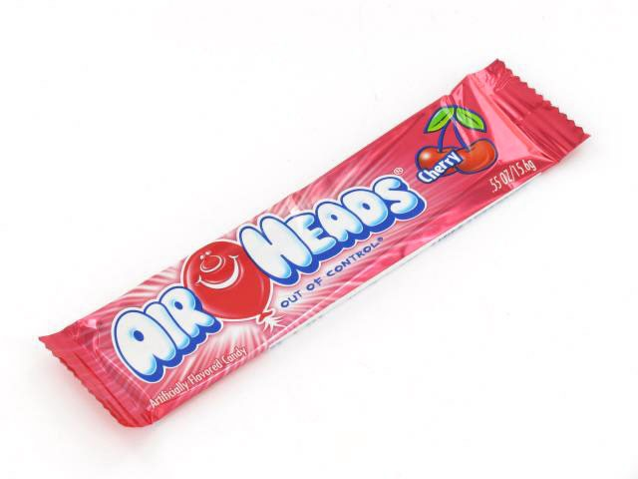

Slide 17
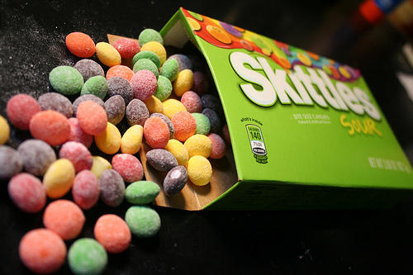

Slide 18
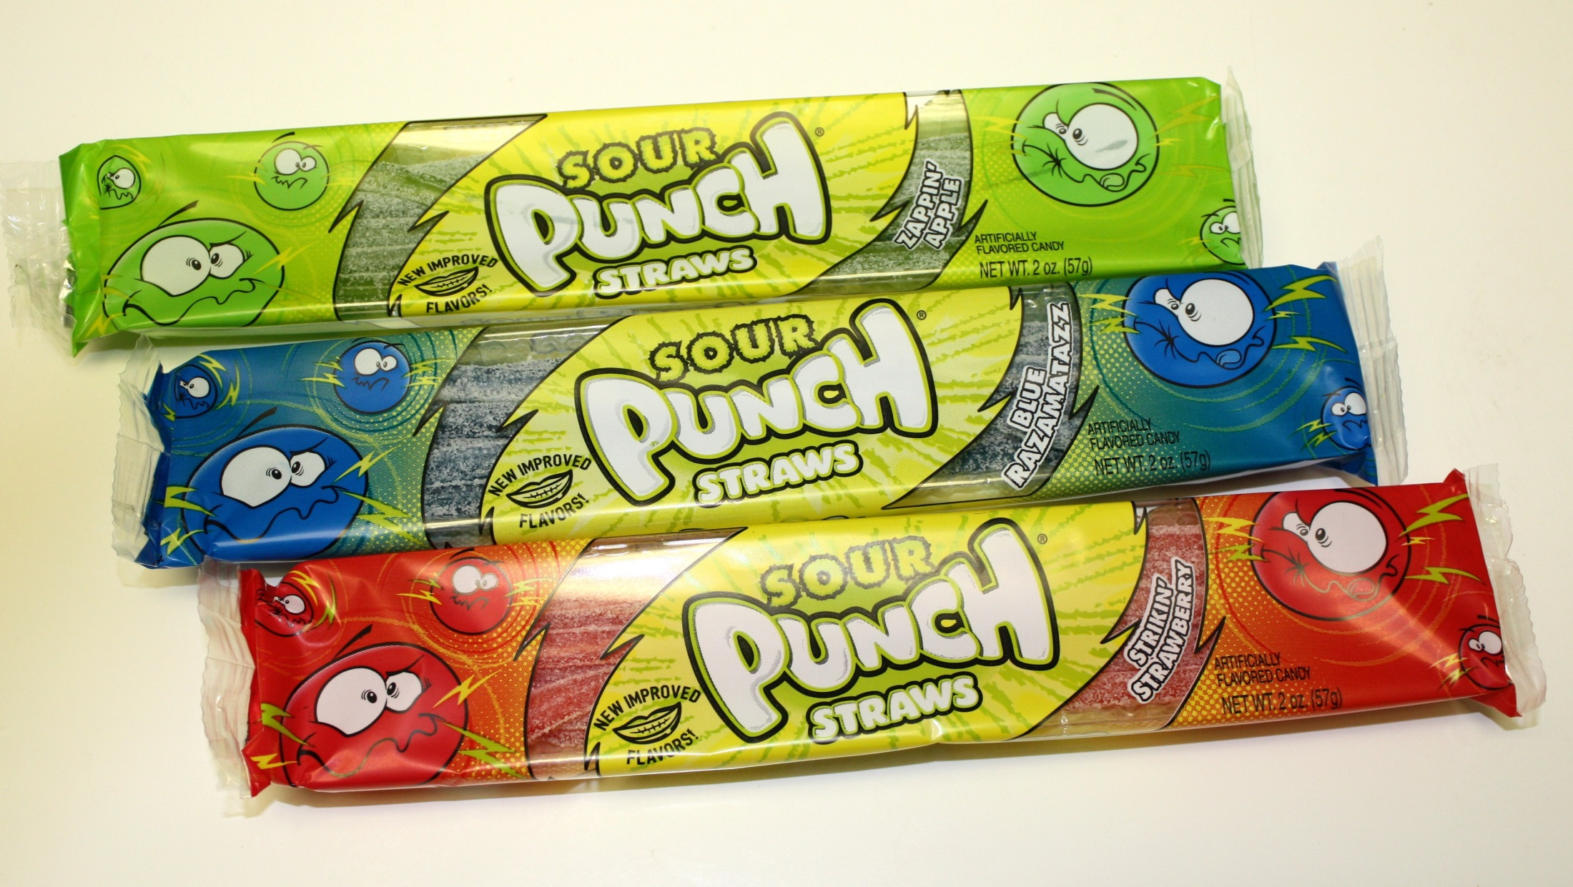

Slide 19
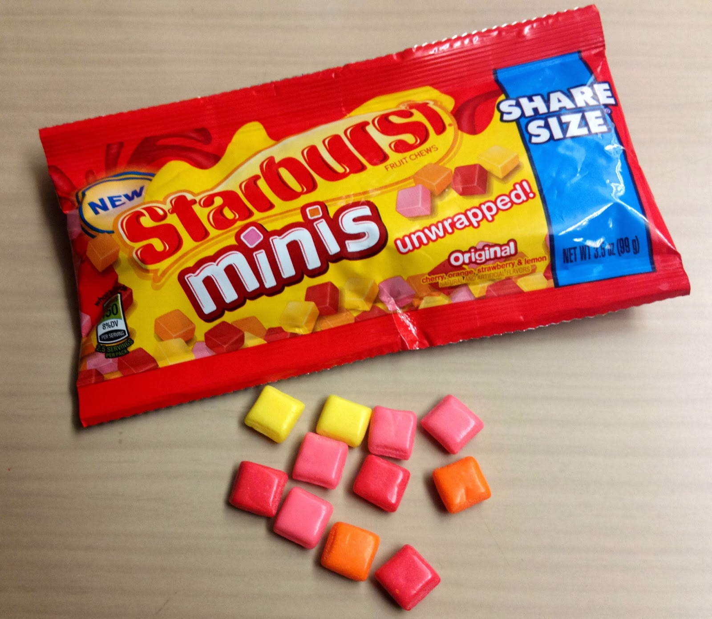

Slide 20
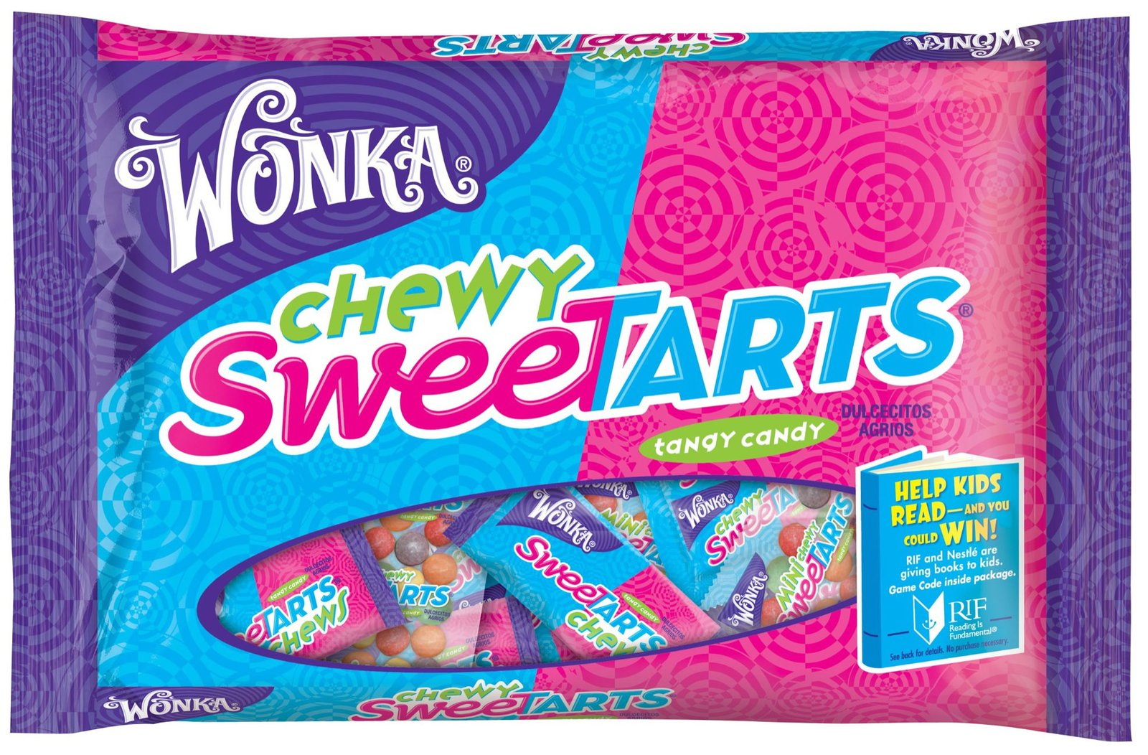

Slide 21
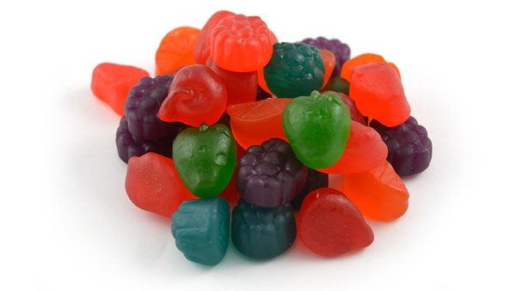

Slide 22
What’s So Bad?
Sugar + Acid
Notes:
Acid in drinks and some candy can cause dental erosion. When consumed frequently, this acid can soften the protective enamel which dissolves then exposes the second layer of tooth. The sugar in the drinks and candy feeds bacteria in the mouth which can cause decay. Bacteria have a much easier time eating through soft enamel.

Slide 23
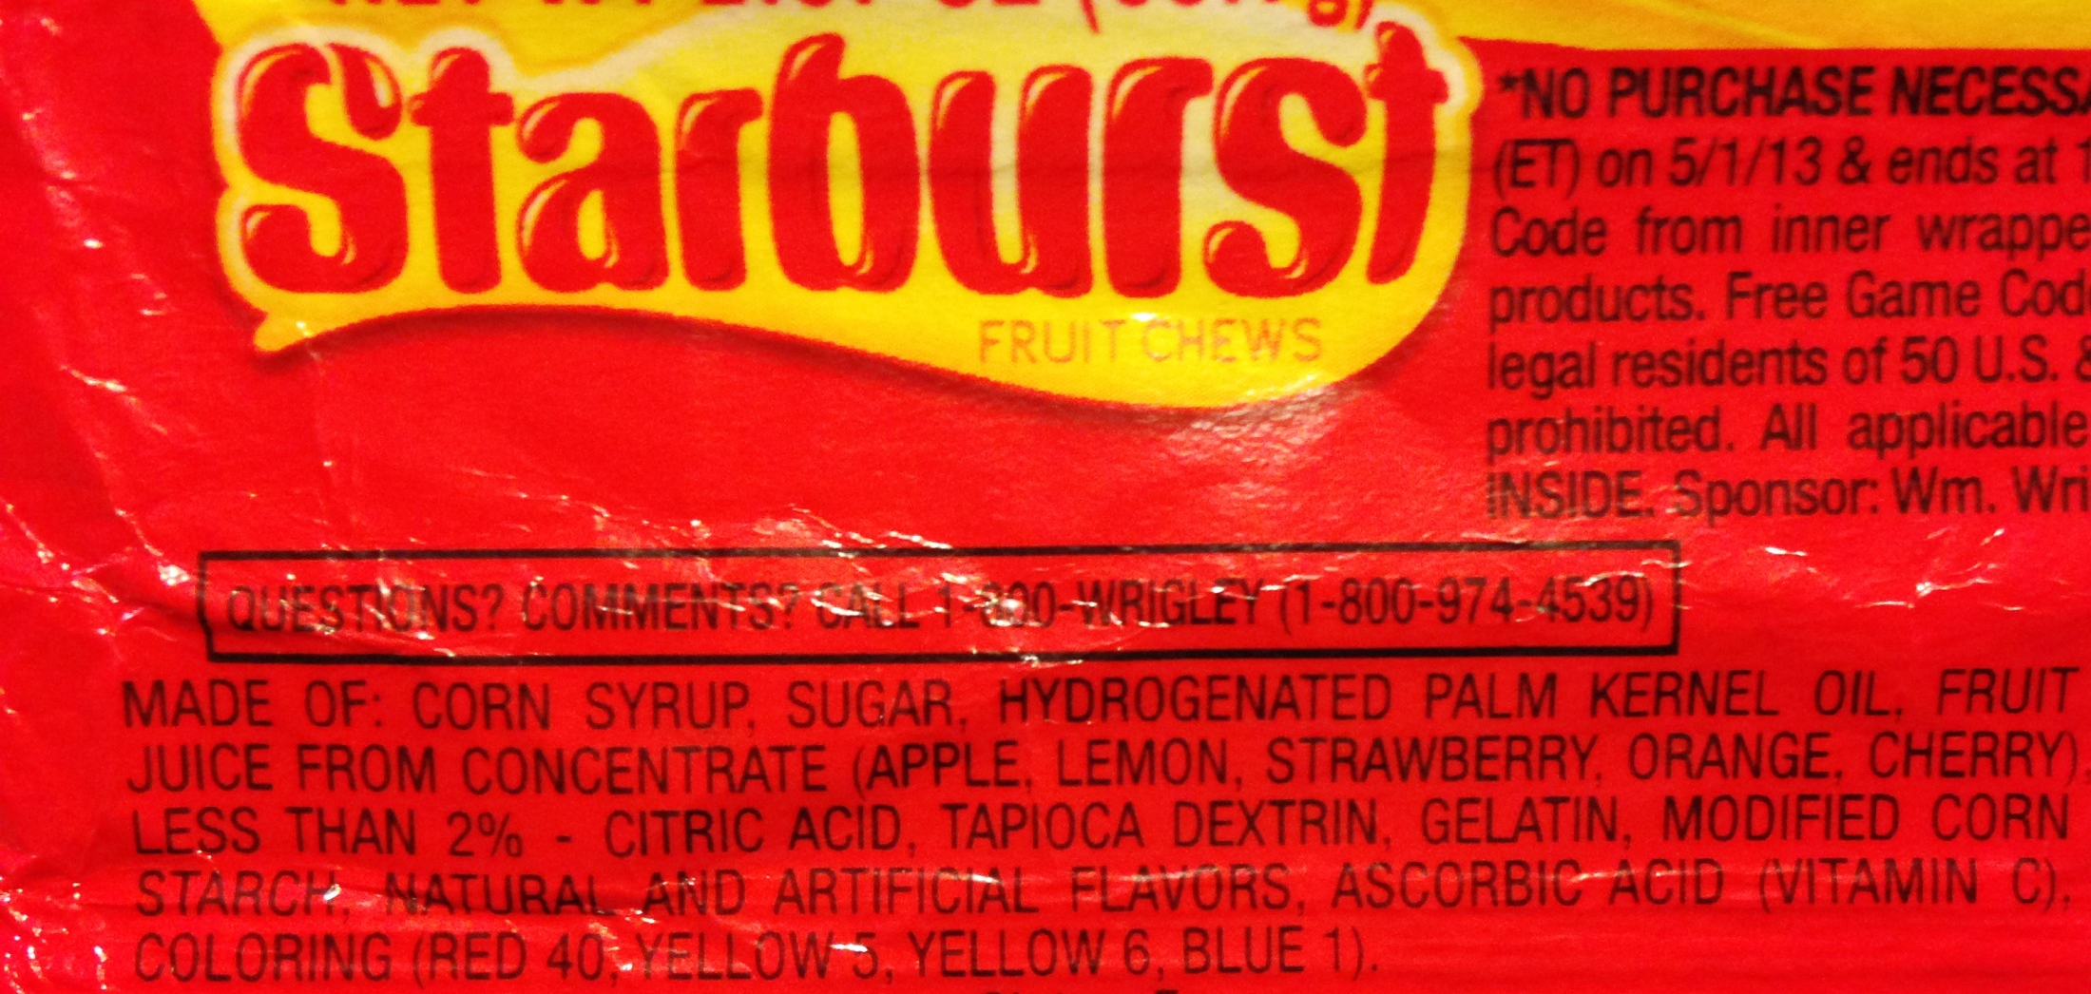
Notes:
Show Labels … Tell them they all are becoming good readers and so that helps them learn things about their world. They can read the label on candy and soda and see the bad stuff that’s in it!

Slide 24
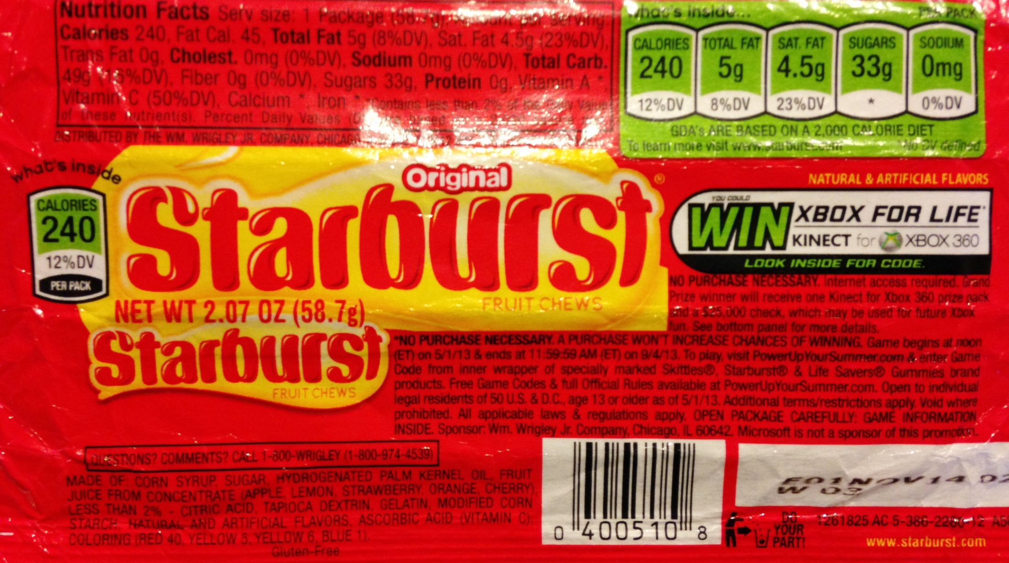
YIKES!
Notes:
Kids your age only supposed to have 3 teaspoons a day (12 grams) … Starburst is 8 teaspoons JUST in that pack of candy

Slide 25
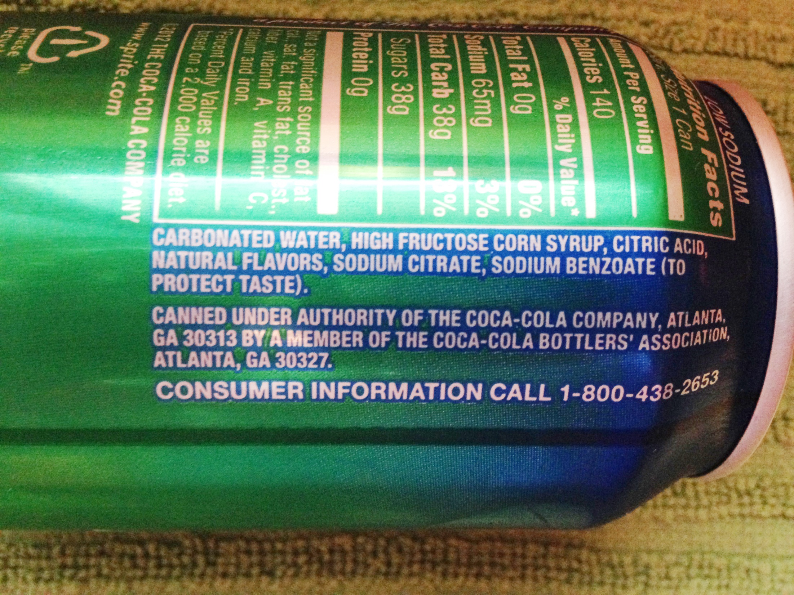

Slide 26
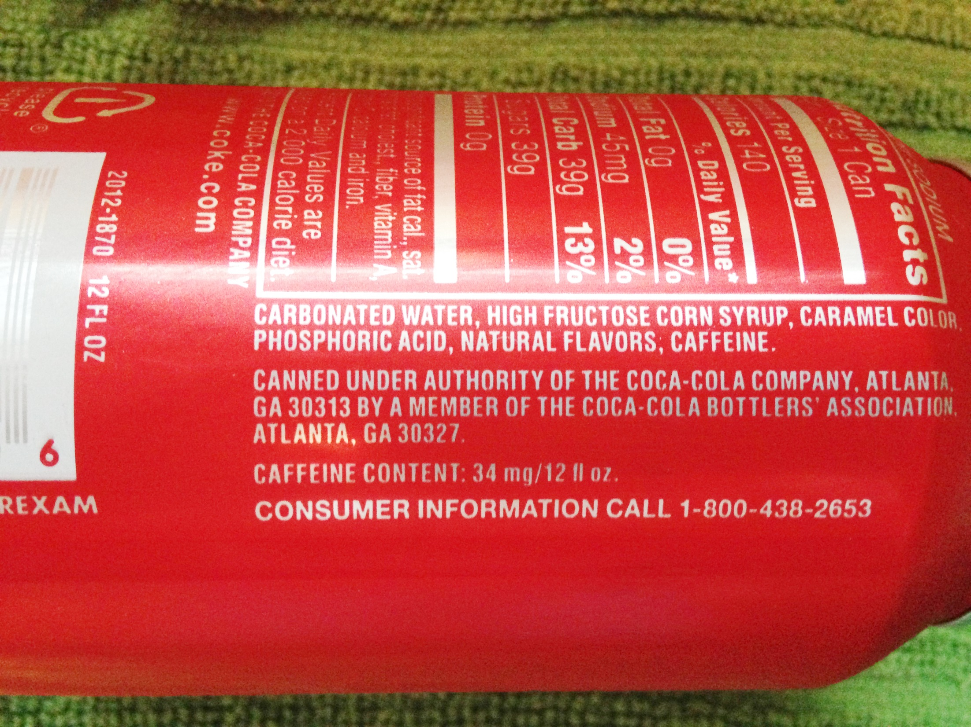

Slide 27
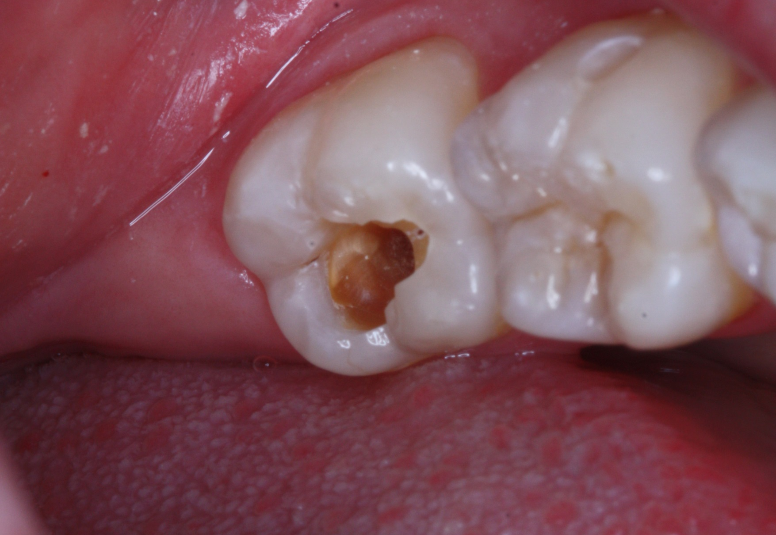
What’s the BIG DEAL? Cavities!
Notes:
Sugar + Acid = Bad!
Talk about how plaque gets on your teeth. Acid in candy and drinks makes your enamel weak … think of it as armor for your teeth. But acid can make little holes in it. Then, the sugar in that candy and drink can go in and attack your teeth and make cavities.

Slide 28
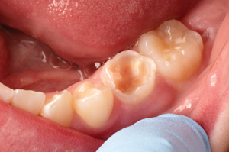

Slide 29
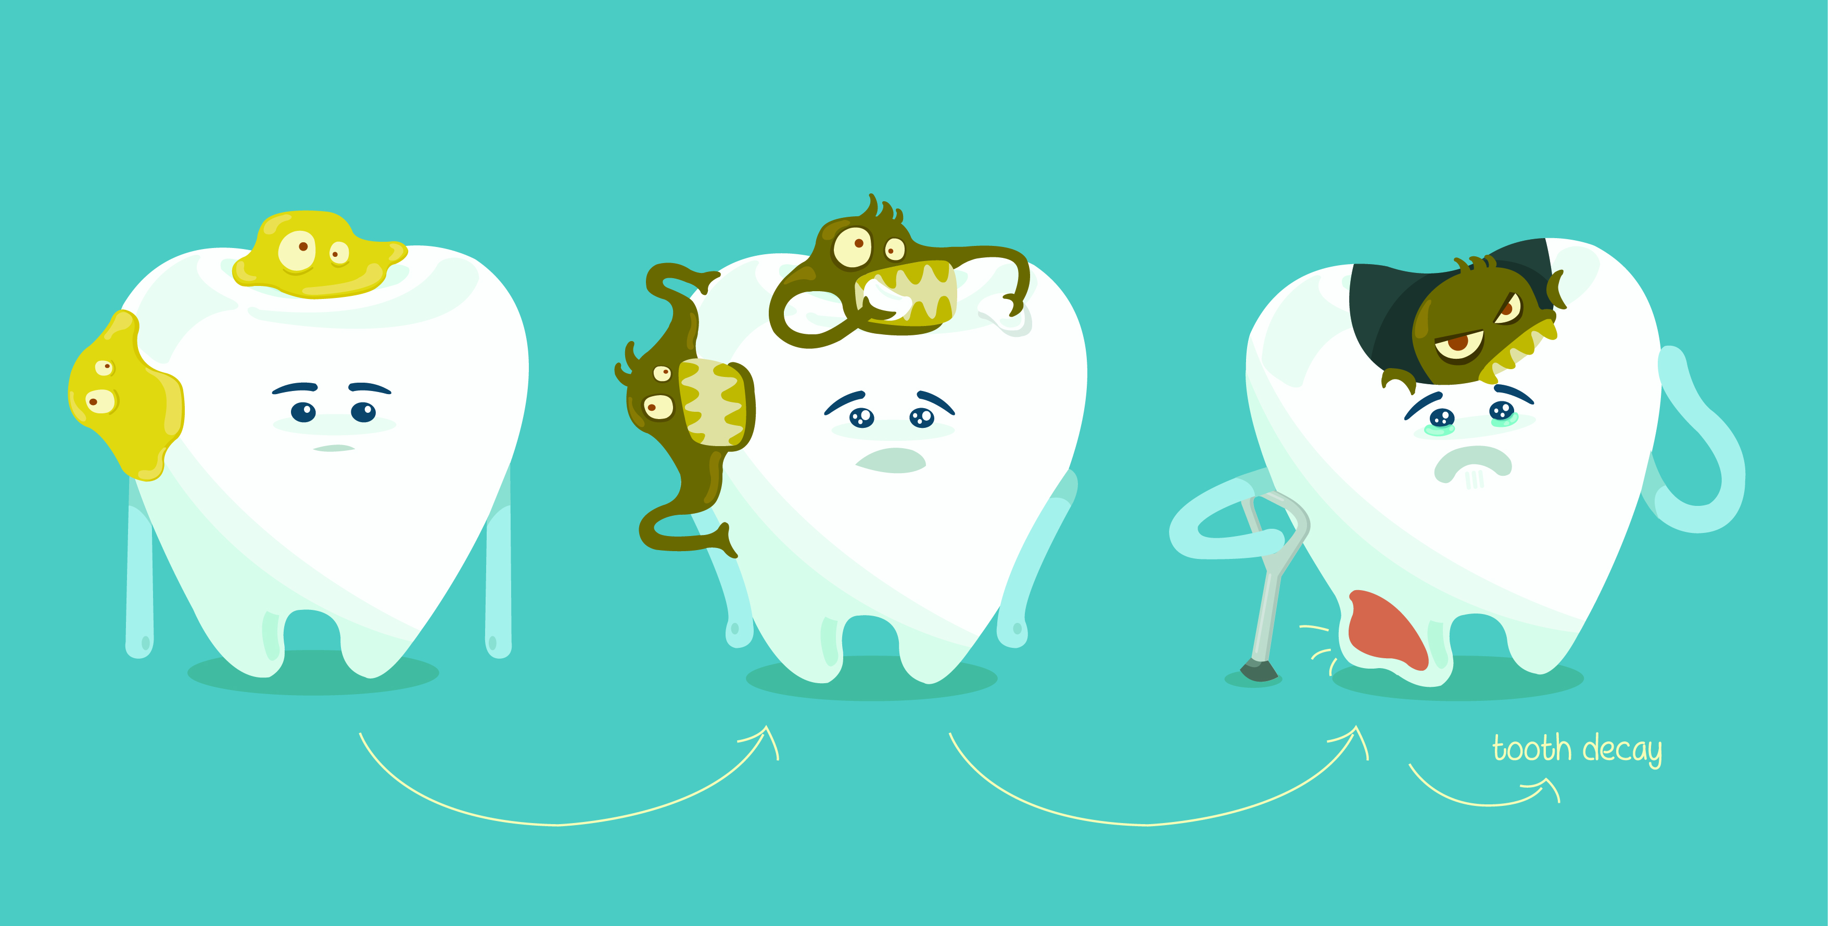
Notes:
I like to call them “Sugar Bugs” because we have bacteria in our mouth already. If we eat and drink lots of sugary stuff, we just feed that bacteria and they can make more cavities!

Slide 30
“Good for You”
Food & Drinks
Notes:
What can you eat that is better?
Show better food and drink choices and discuss that not only do these not have the high amount of sugar and acid, but they also contain nutrients that help you grow.

Slide 31
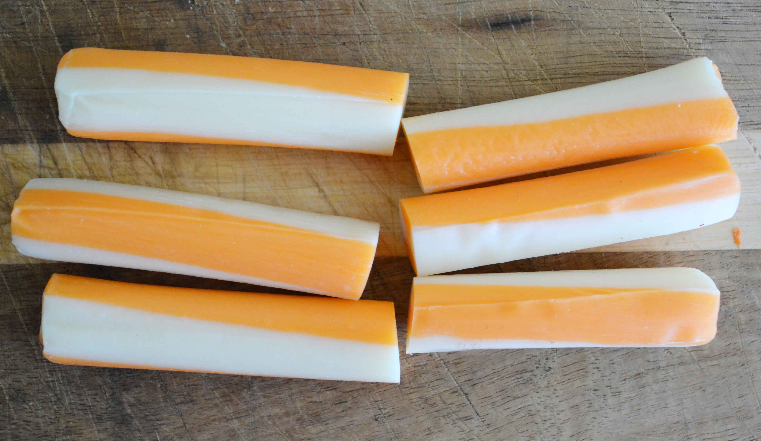

Slide 32
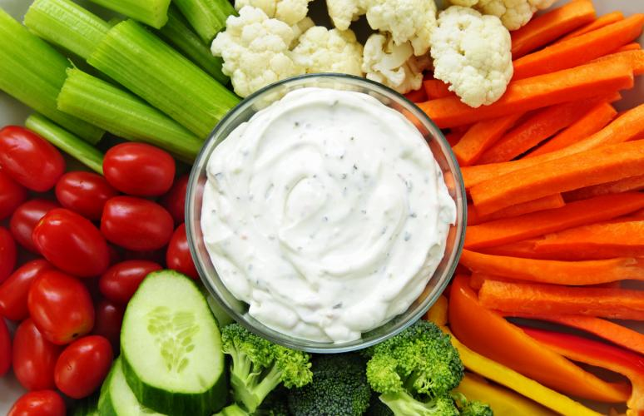

Slide 33
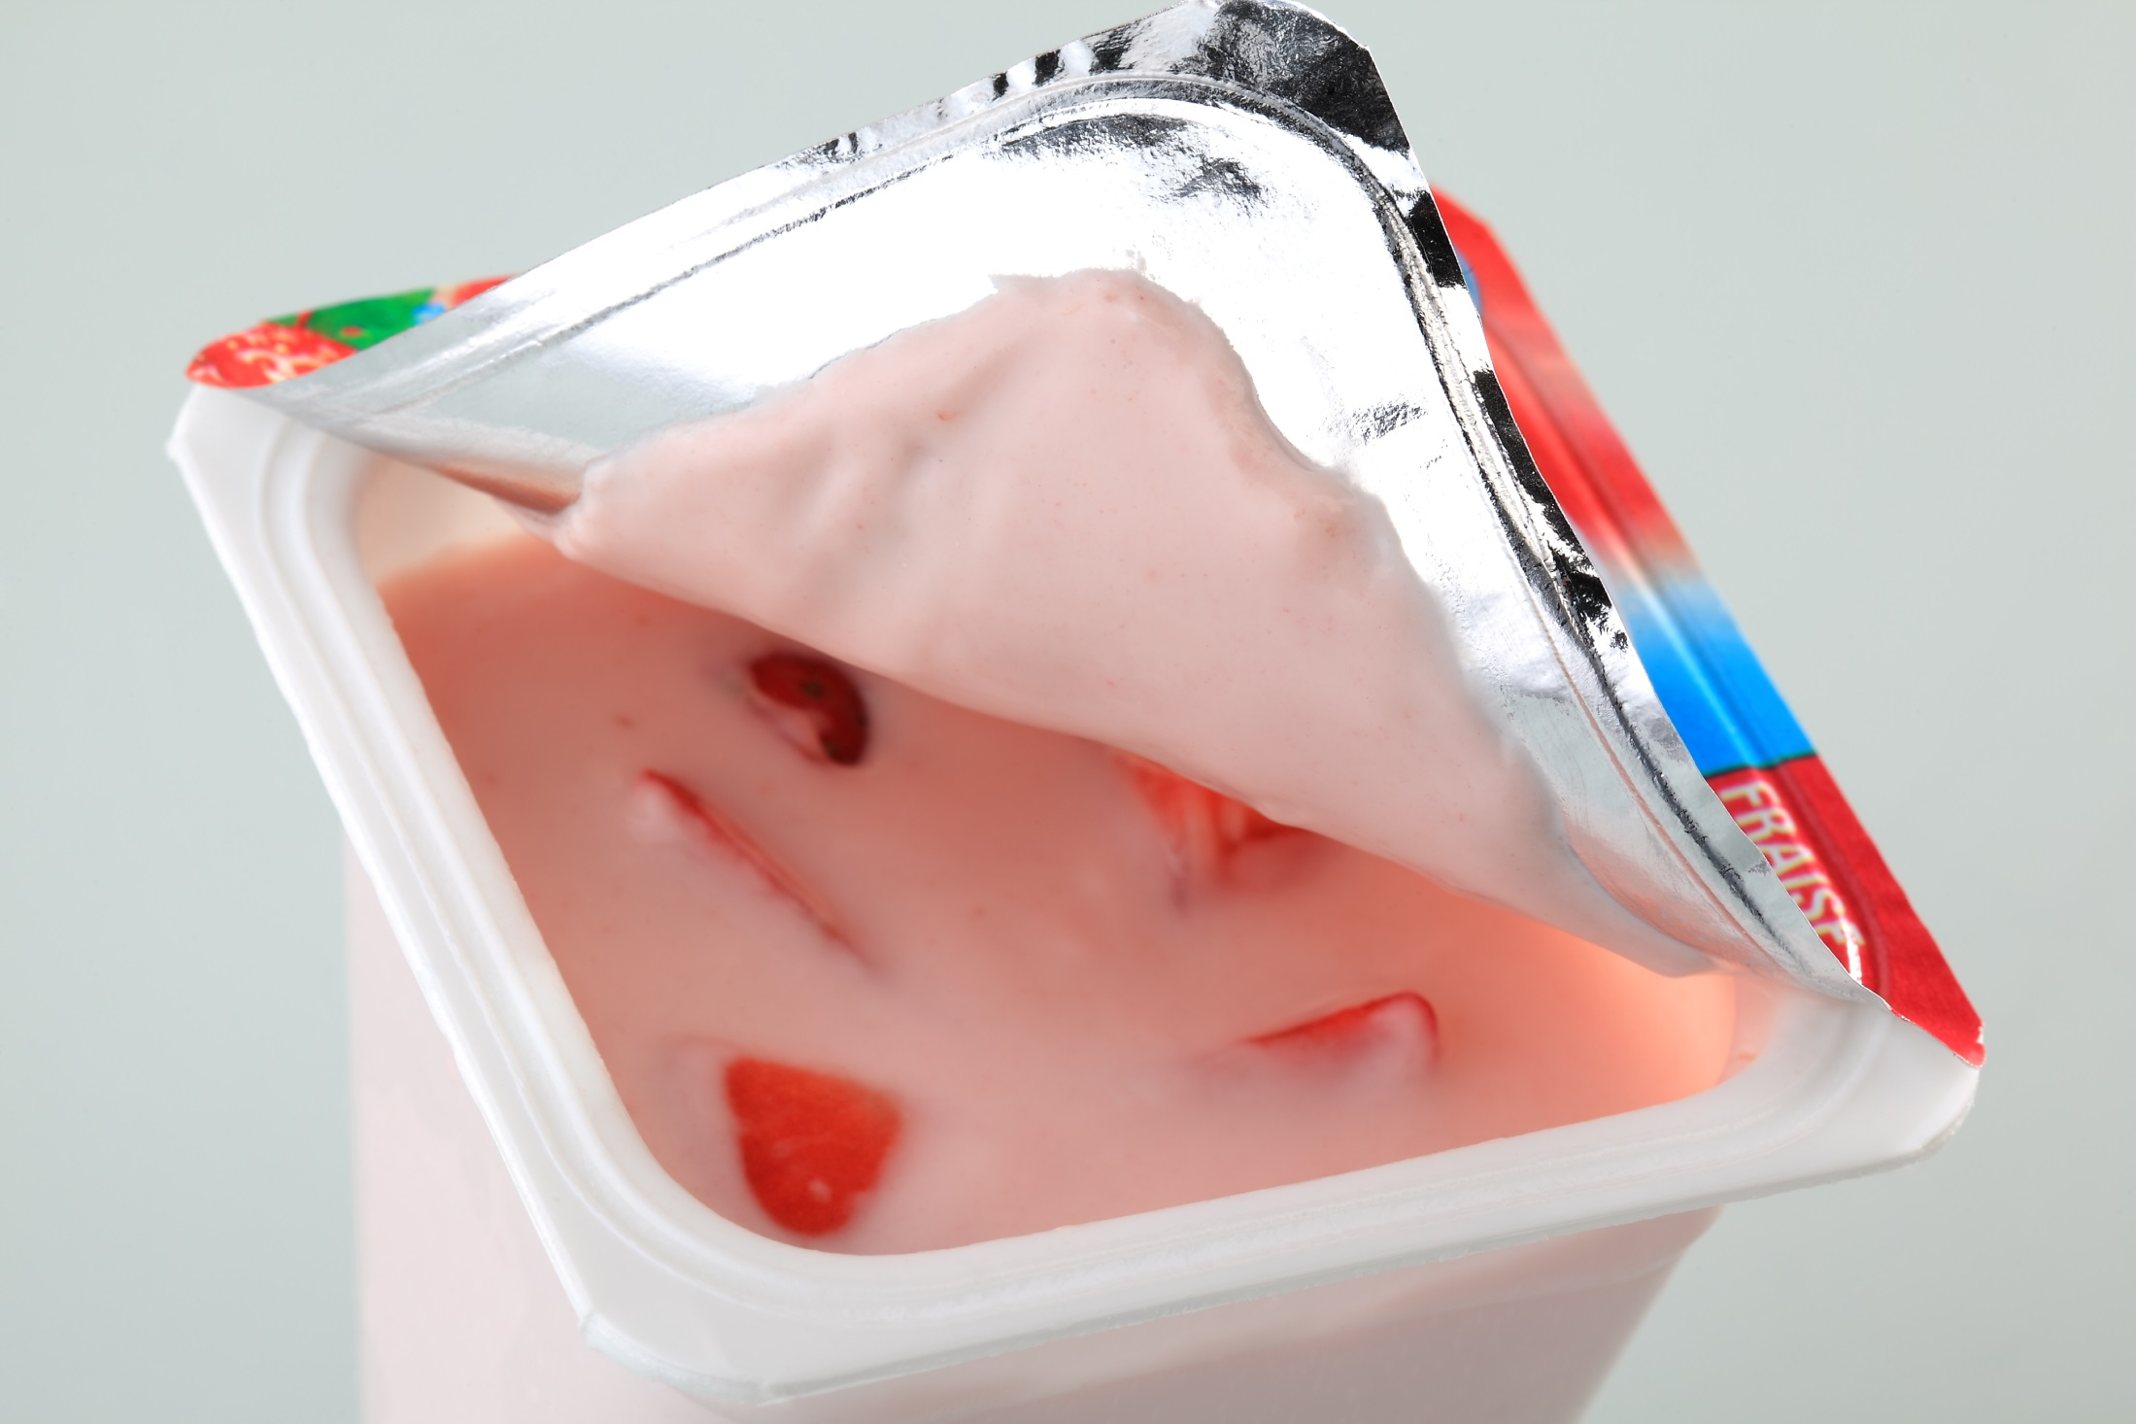
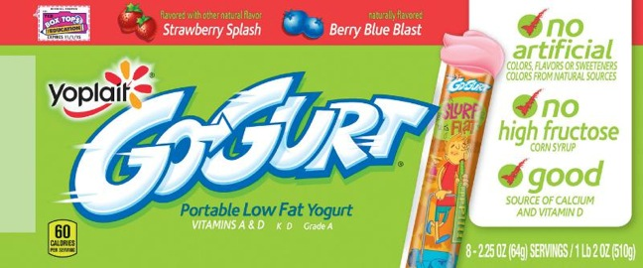

Slide 34
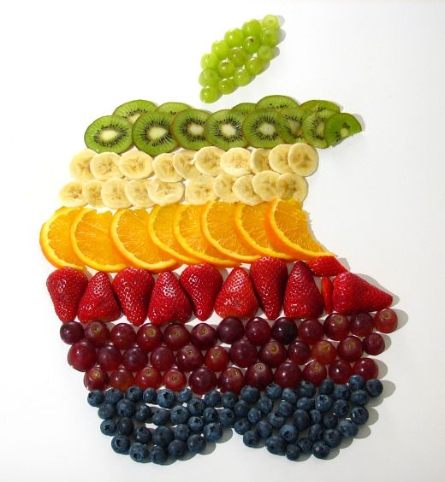

Slide 35
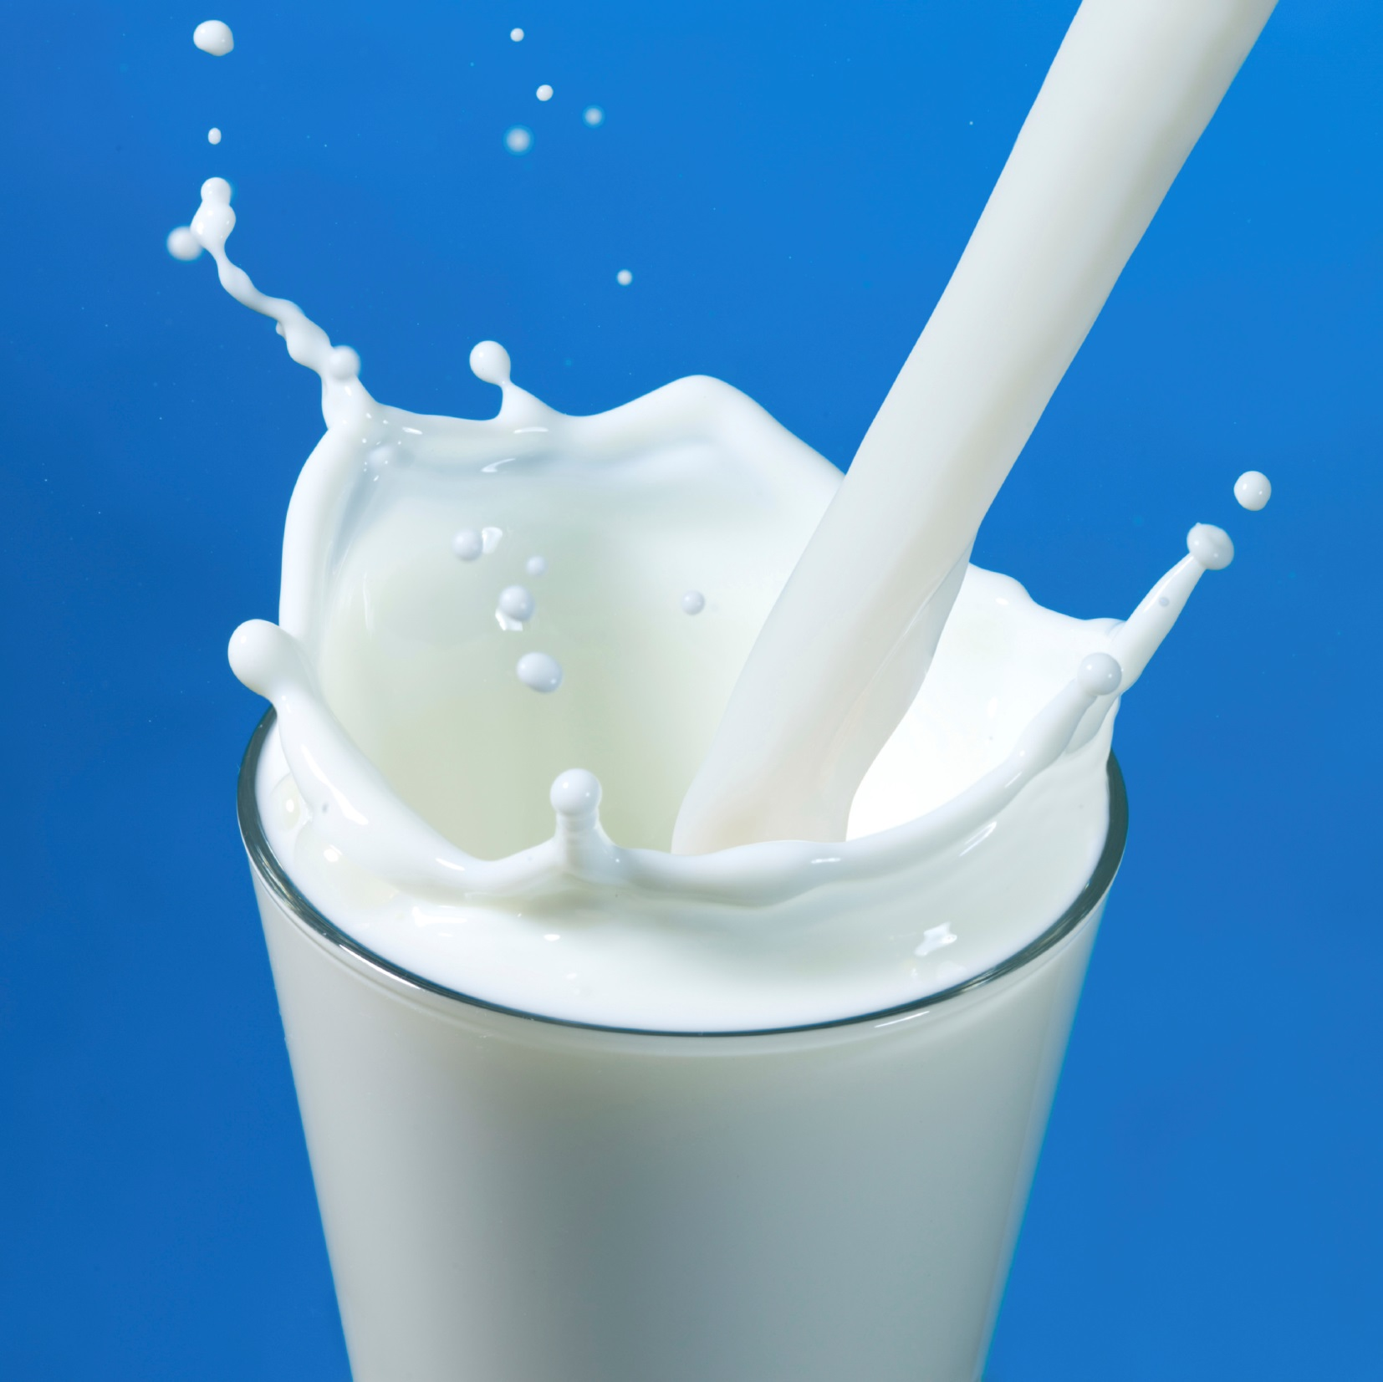

Slide 36
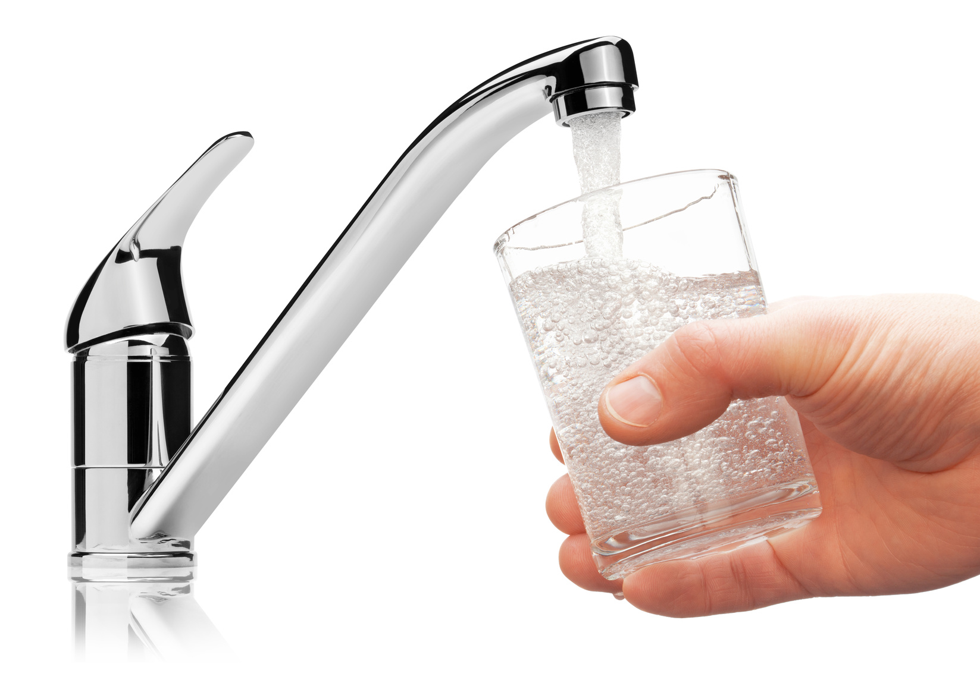

Slide 37
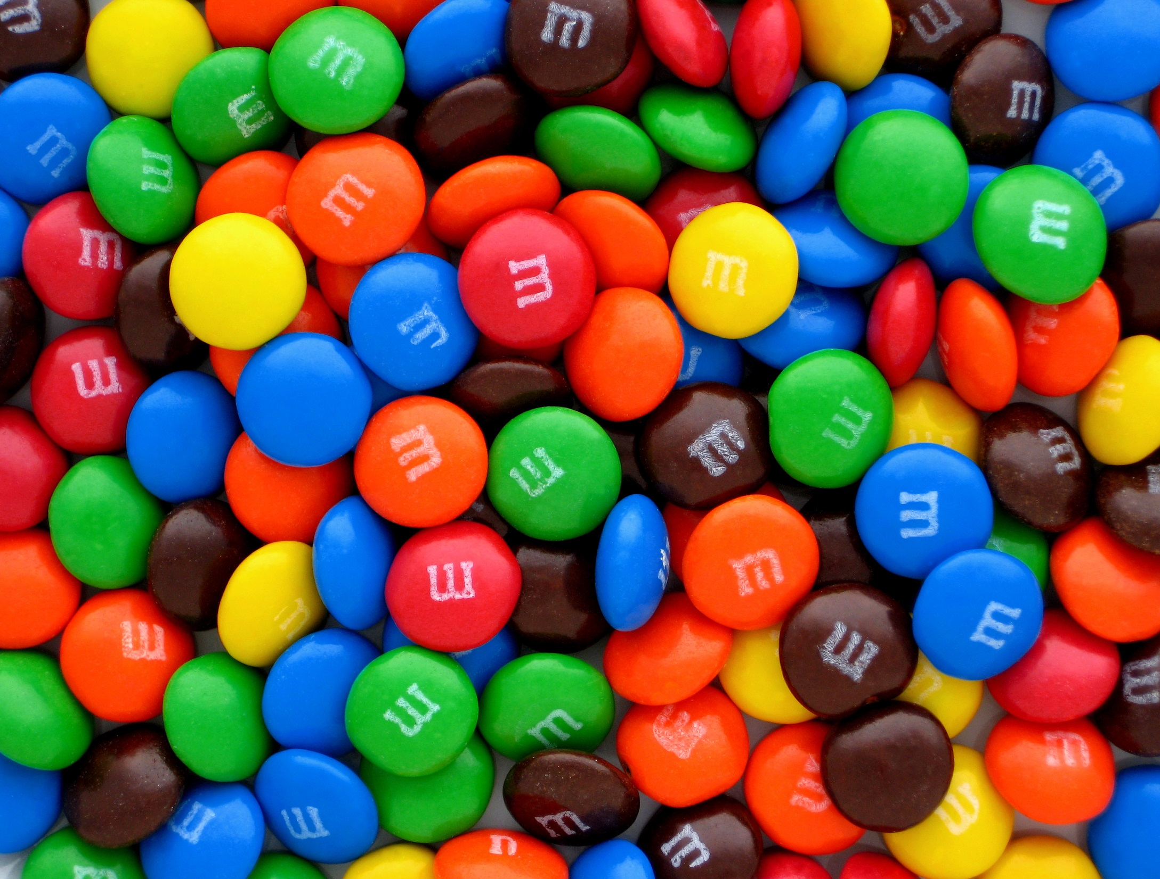
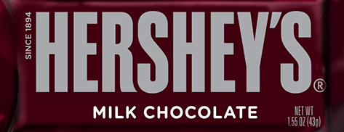
Still not great … but washes off teeth faster and not so much acid!
Notes:
I’m not saying you can’t ever have candy as a treat … but it should be just that, a treat—not something you should have every day.
And, if you do have candy, something like chocolate that melts and washed off your teeth easier and doesn’t get stuck (or is something you can suck on for a long time) is better than other candy choices.
Also, when you do have candy, it’s a good idea to rinse with water after you finish eating it. Example of eating chocolate is better because it doesn’t STICK to your teeth and between your teeth.

Slide 38
Take Care of Your Teeth
Brush & Floss!
Notes:
Brushing
Stress 2Min2X Day
A large amount of toothpaste is note needed

Slide 39
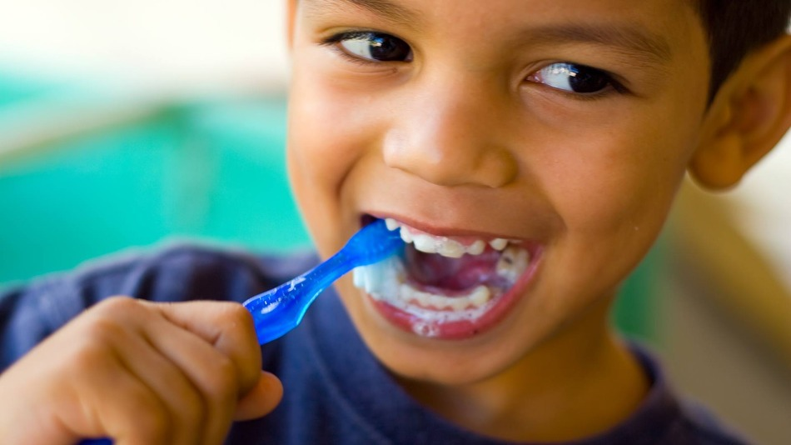
Brush Your Teeth 2 Times Each Day

Slide 40
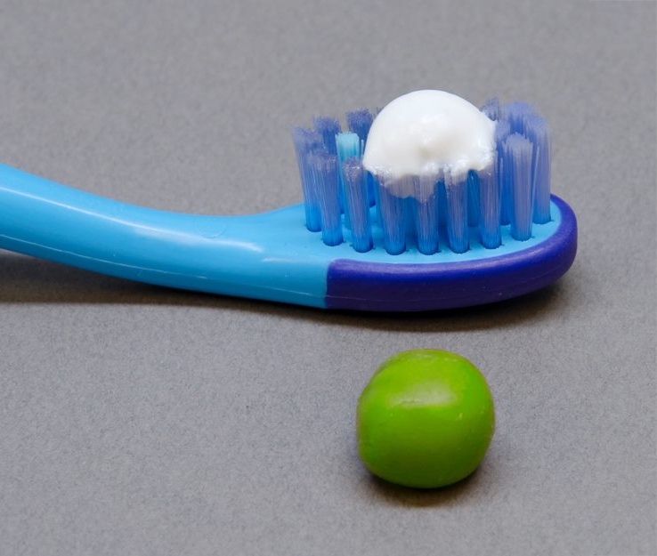
Just a PEA-size amount of toothpaste!

Slide 41
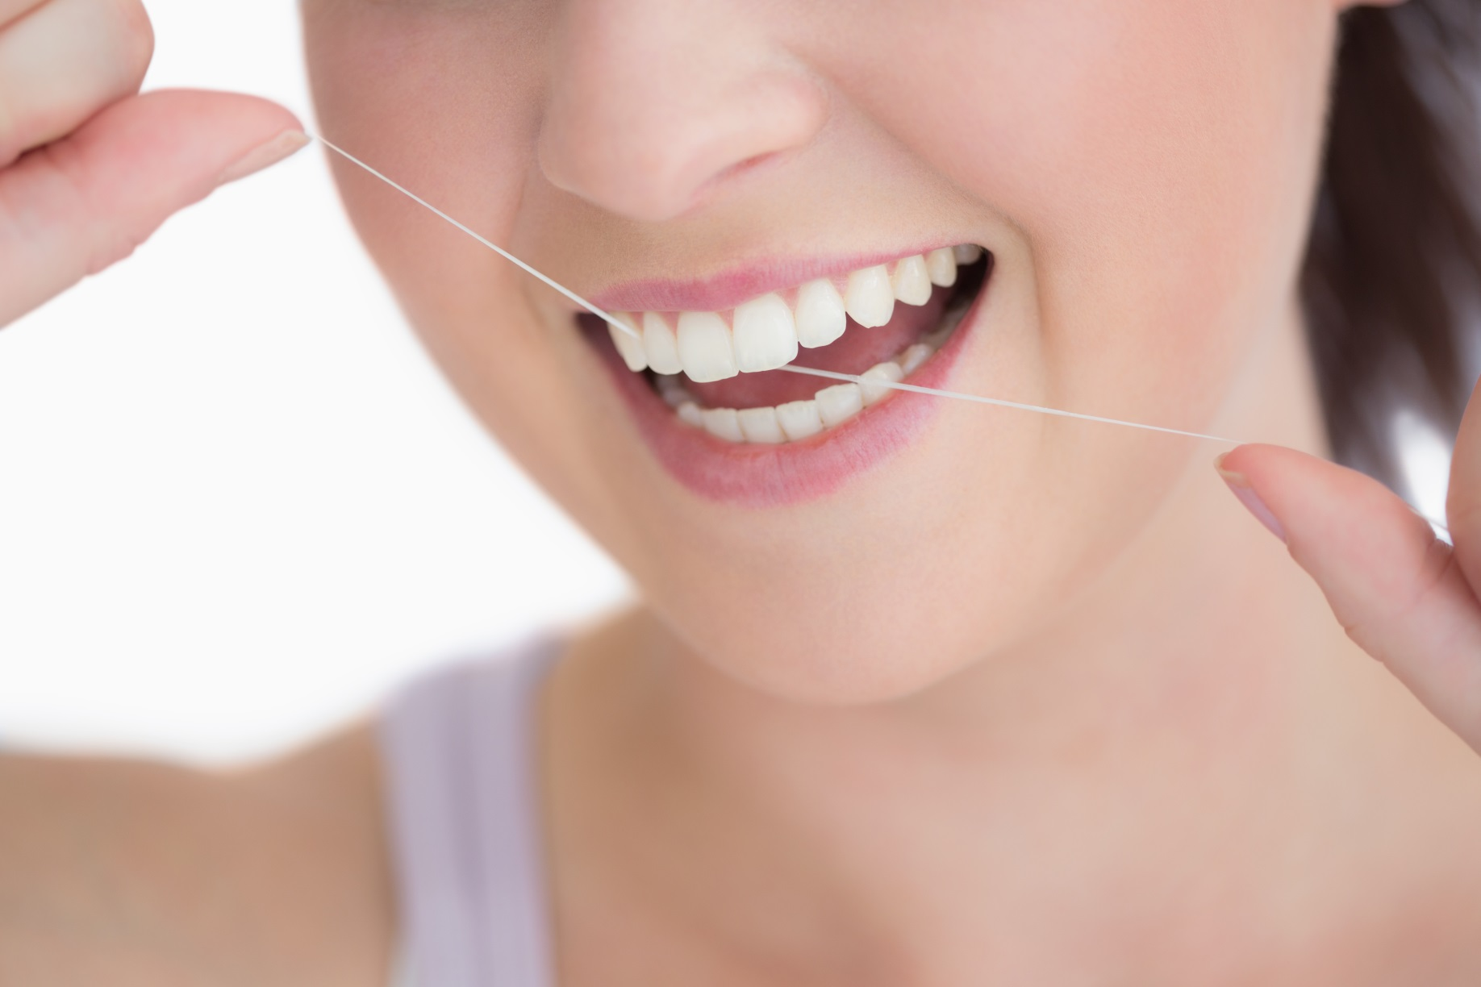

Floss Your Teeth … 3 Times Each Week
Notes:
Flossing
Daily is great, but even if they did EVERY other day or even 3 times a week, that would be awesome (M, W, F)!
We know too it may be easier for young kids to use floss picks rather than actual floss

Slide 42
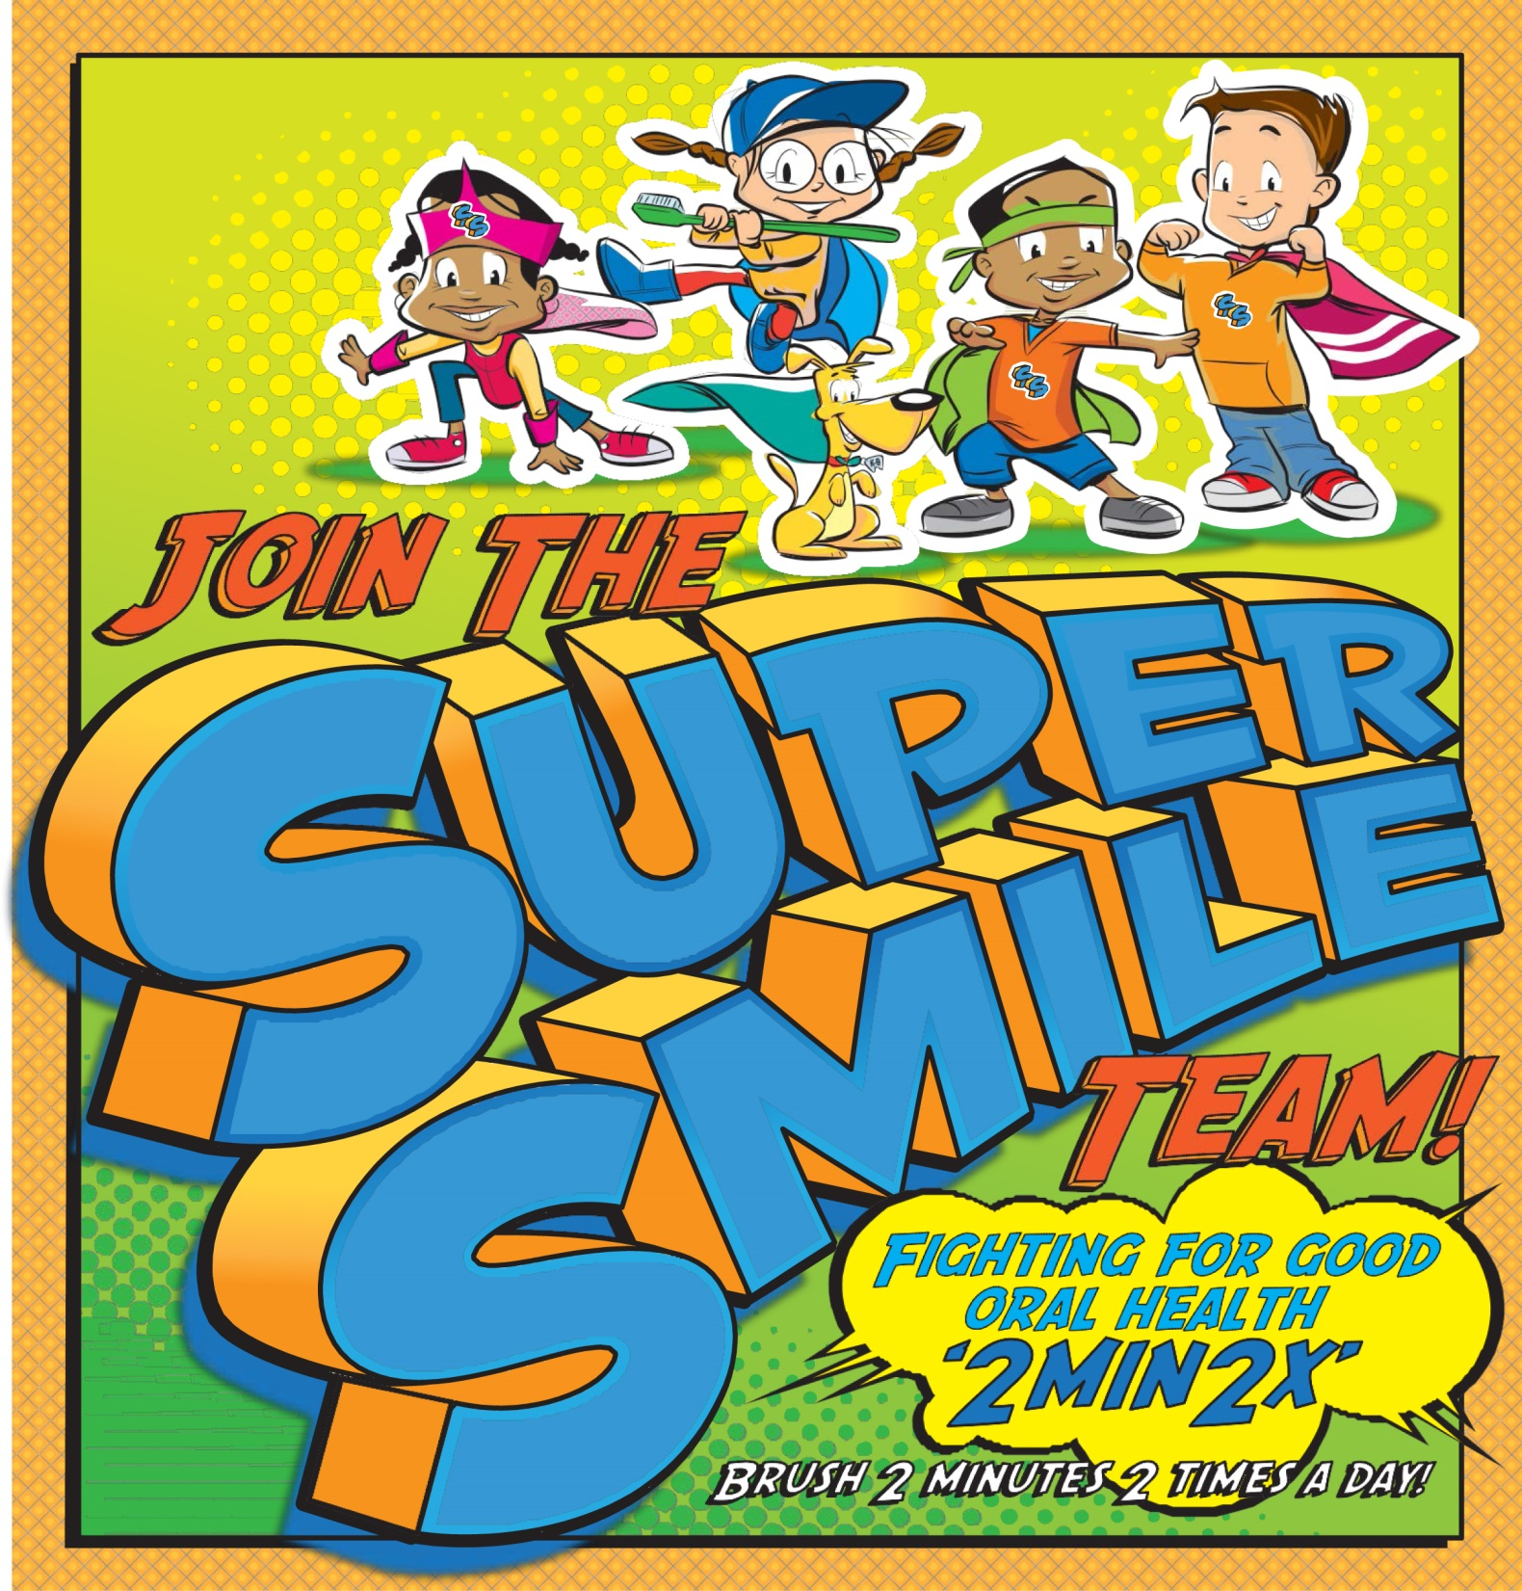
Notes:
Close with Take Away Points …
Why Teeth Are Important
Help Us Eat
Help Us Speak
Help Us SMILE!
Overall keep us healthy by having a clean, cavity free mouth.
Choosing Healthy Foods and Drinks
Limit candy and soda
Choose healthy snacks and fruit for something sweet
Brushing and Flossing
Stress 2Min2X Day
Floss as much as you can

Slide 43

Cool games, info & more at

