Slide 1
Healthy Mouth Healthy Body
Notes:
The health of your mouth is important to the health of your body, I am going to remind you about some important aspects of your teeth.
Remember, dental cavities are preventable. Which means we can do something about it.
If I have any football fans out there, think about prevention as being a really great offense and defense.
How do we prevent dental decay and cavities? A LOT has to do with what we eat and drink (offense) and how we take of our teeth after we eat and drink (defense).

Slide 2
Notes:
This picture is of a human skull 100,000 years old.

Slide 3
Notes:
And this one is of a Viking skull. They were around in about the years 700 to 1000. In either case, they didn’t have toothbrushes. They didn’t have floss or toothpaste, and they certainly didn’t have Listerine. Yet somehow, their mouths were a lot healthier than ours are today. Why?
In large part because of their diets. Which were composed of meats, vegetables and nuts … maybe some fruits.
But eventually our diets changed and became more sugar based—and not sugars found in milk or fruit but in processed foods, candies and soda. And, it’s kind of complicated, but it affected the bacteria in our mouths, which can cause cavities. Add the amount of acid we consume to that … and we’re in trouble!

Slide 4
Prevention (Offense)
Notes:
How do we prevent dental decay and cavities? A LOT has to do with what we eat and drink … our offense.
If you remember the football analogy we want to prevent a touchdown … we want to prevent tooth decay.

Slide 5
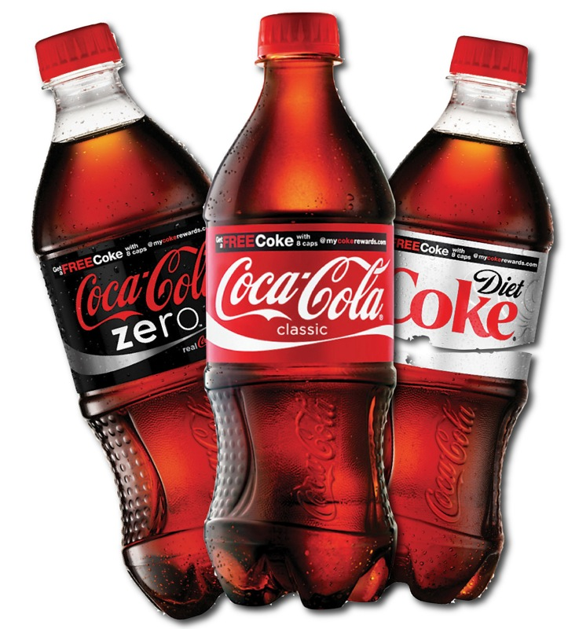
Notes:
Show slides of Soda & Sports Drinks; Candy & Fruit Snacks
Asks, “how many of you like these kinds of drinks and treats” (move quickly through these slides – kids will usually cheer to show just how much they love something that is shown)

Slide 6
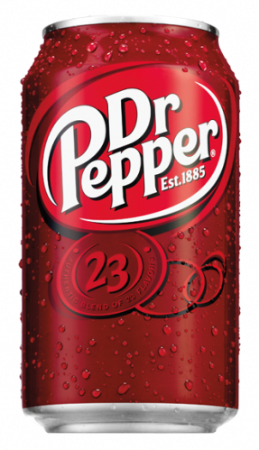

Slide 7
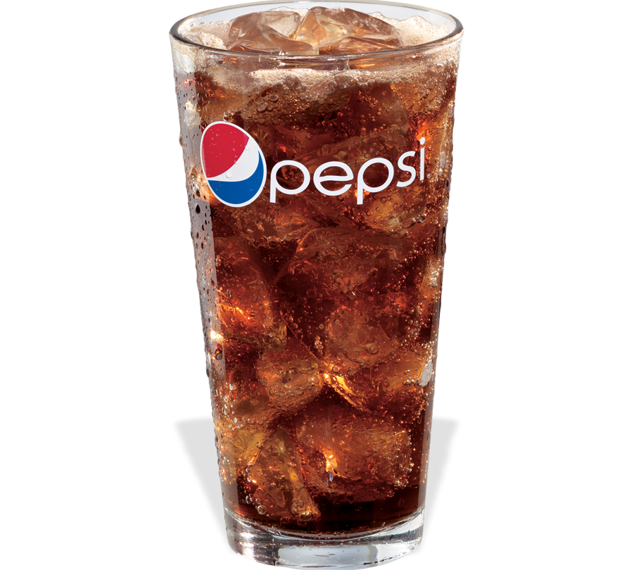

Slide 8
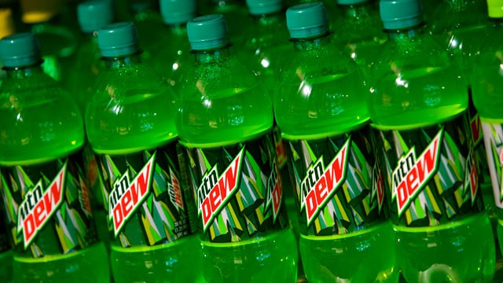

Slide 9
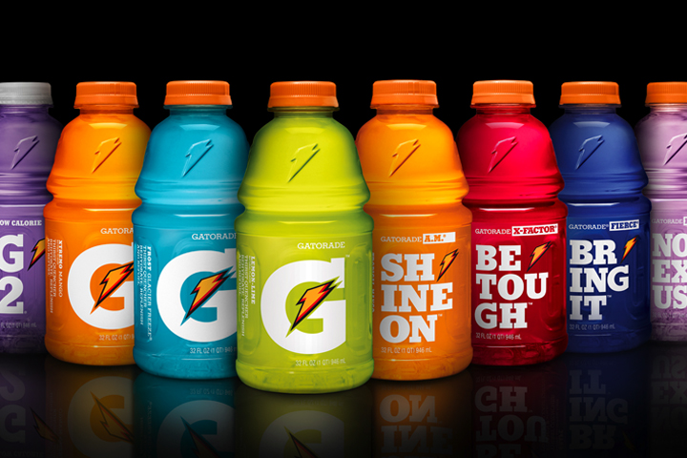

Slide 10
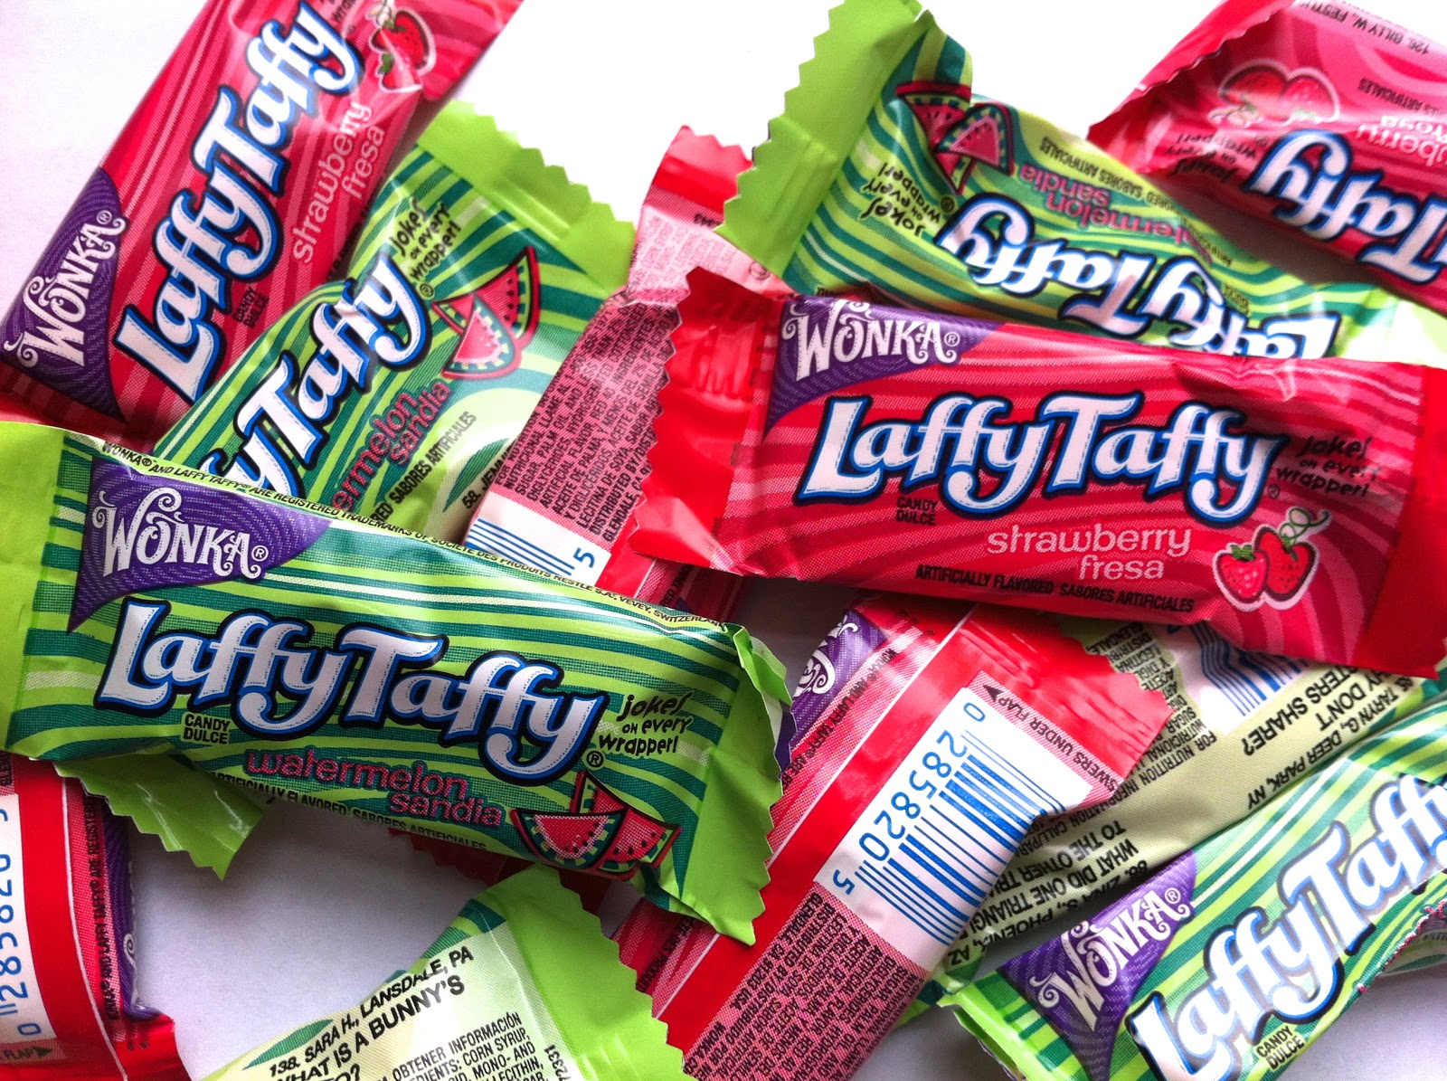

Slide 11
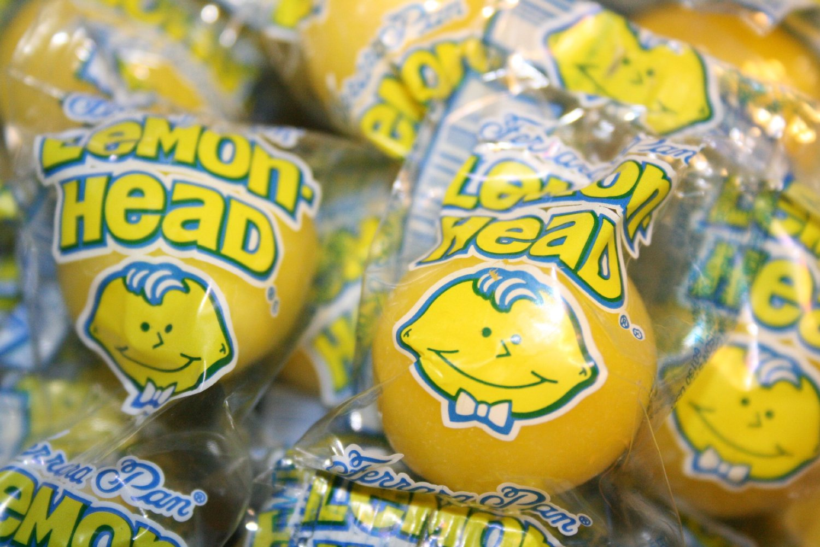

Slide 12
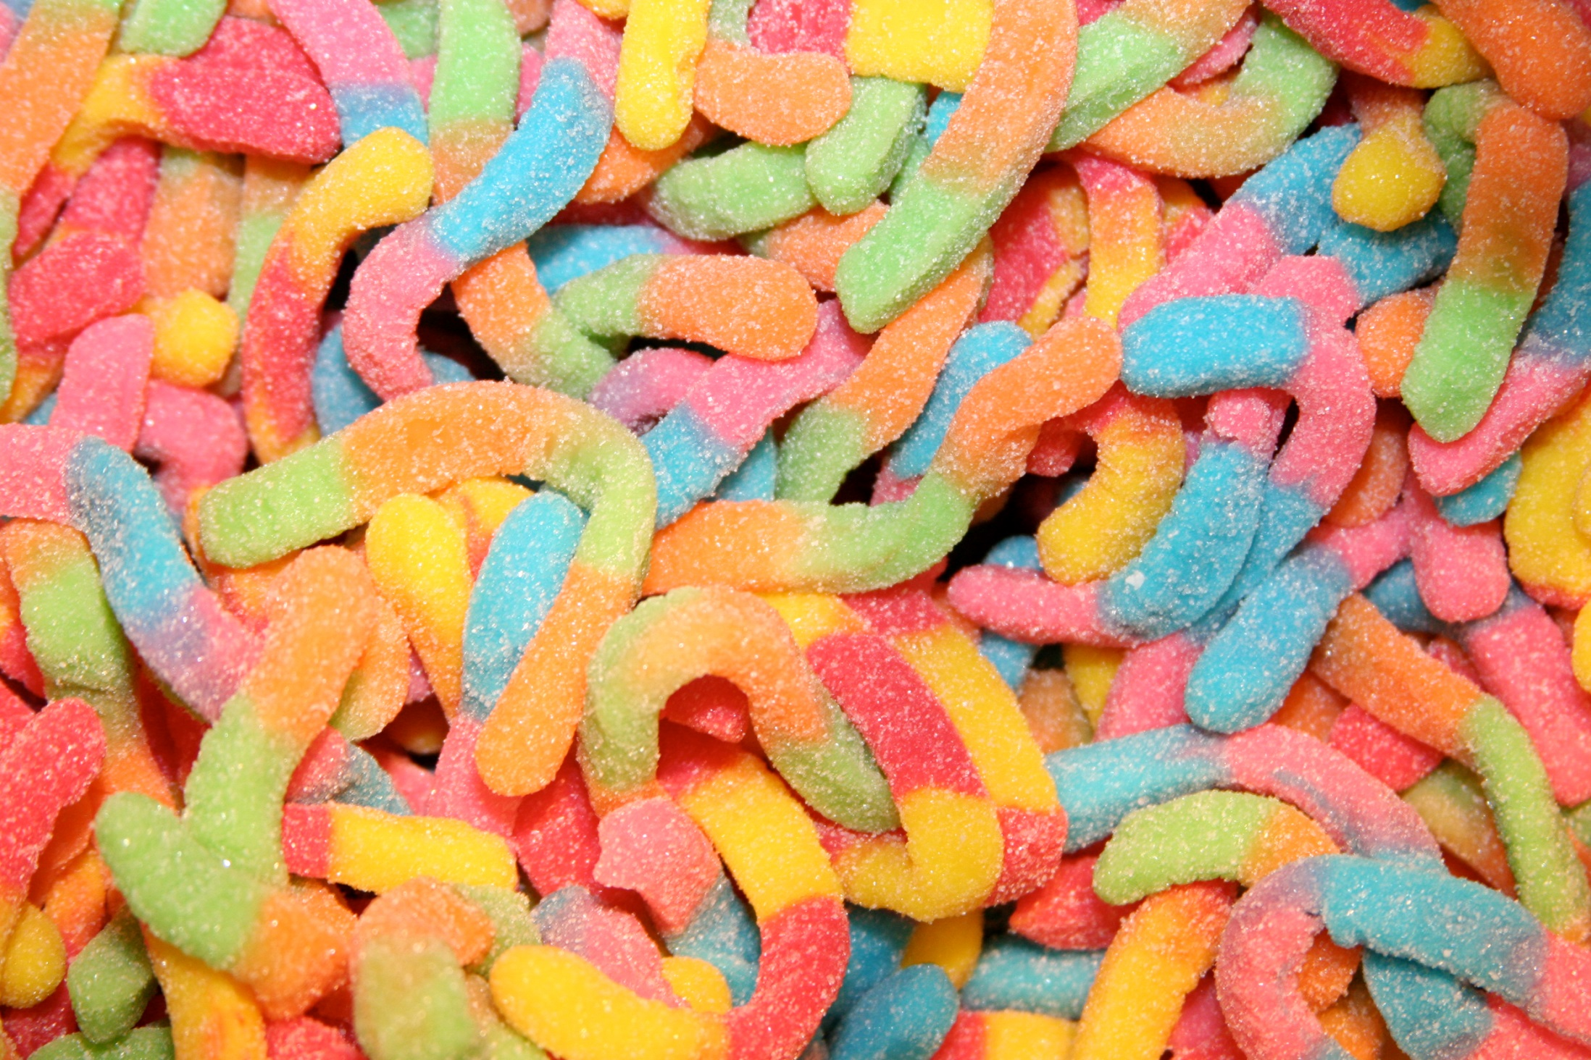

Slide 13
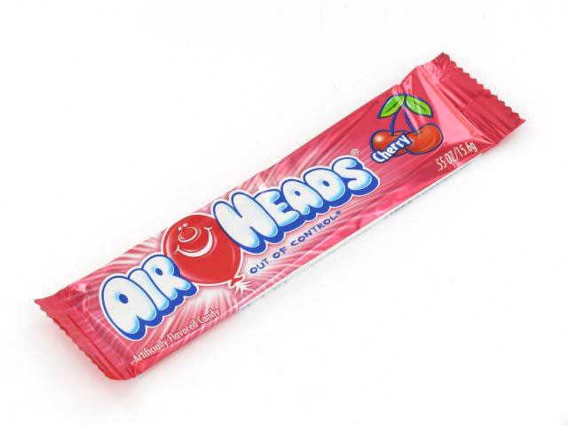

Slide 14
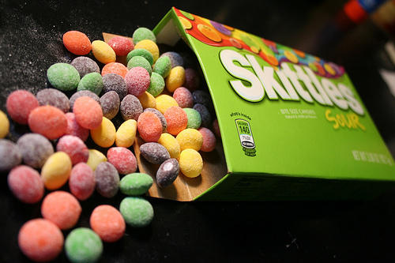

Slide 15
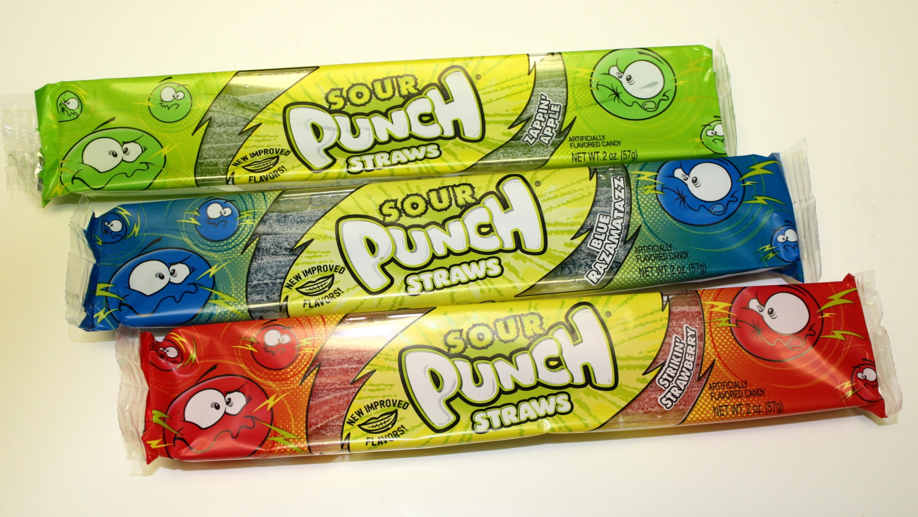

Slide 16
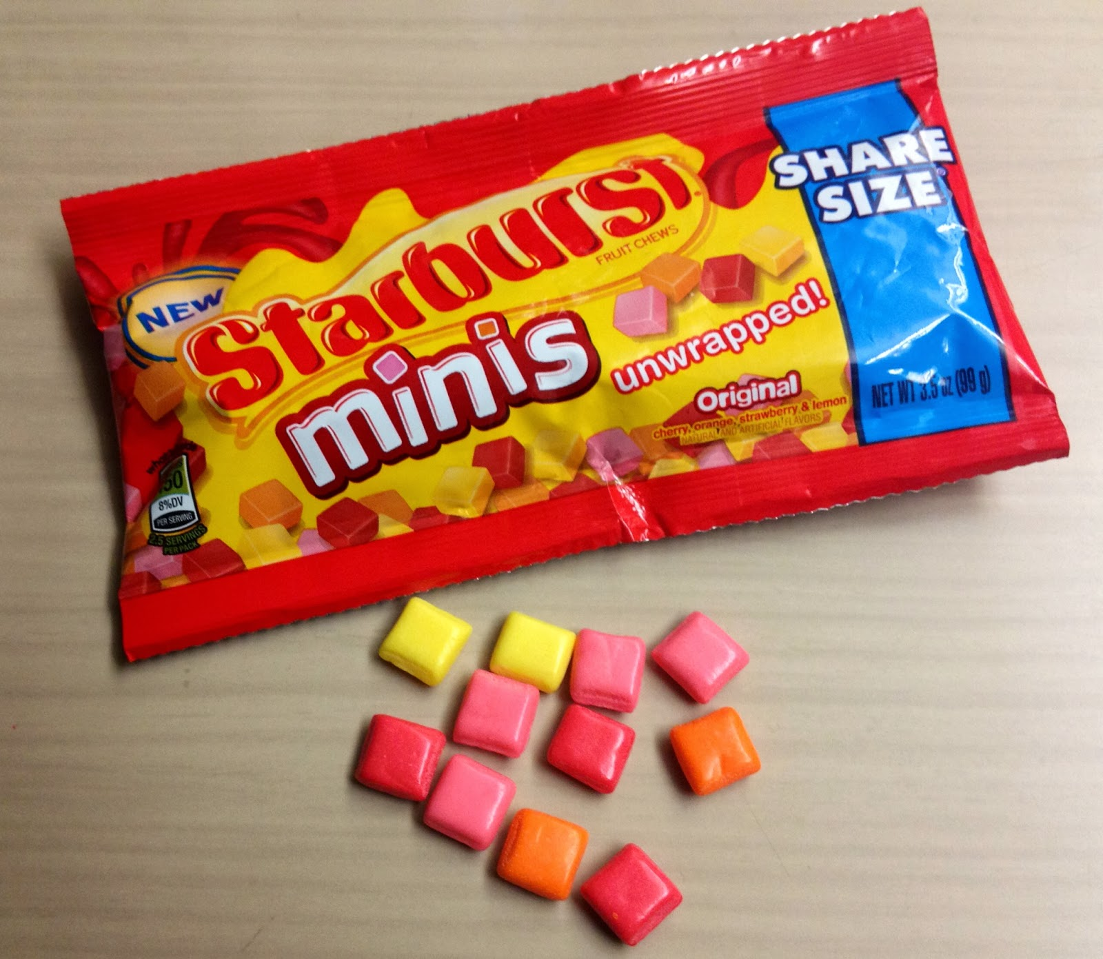

Slide 18
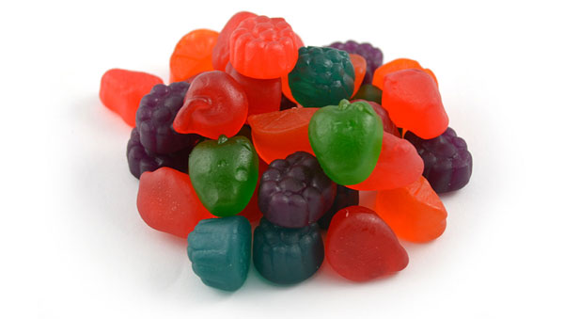

Slide 19
WHY?
Sugar + Acid
Notes:
While I am sure many of you like these kinds of foods, they just aren’t great options for your overall health OR your teeth. WHY? Sugar + Acid (move on to discuss labels)
Acid in candy and drinks makes your enamel weak … think of it as armor for your teeth. But acid can make little holes in it. Then, the sugar in that candy and drink can go in and attack your teeth and make cavities.
Acid in drinks and some candy can cause dental erosion. When consumed frequently, this acid can soften the protective enamel which dissolves then exposes the second layer of tooth. The sugar in the drinks and candy feeds bacteria in the mouth which can cause decay. Bacteria have a much easier time eating through soft enamel.

Slide 20
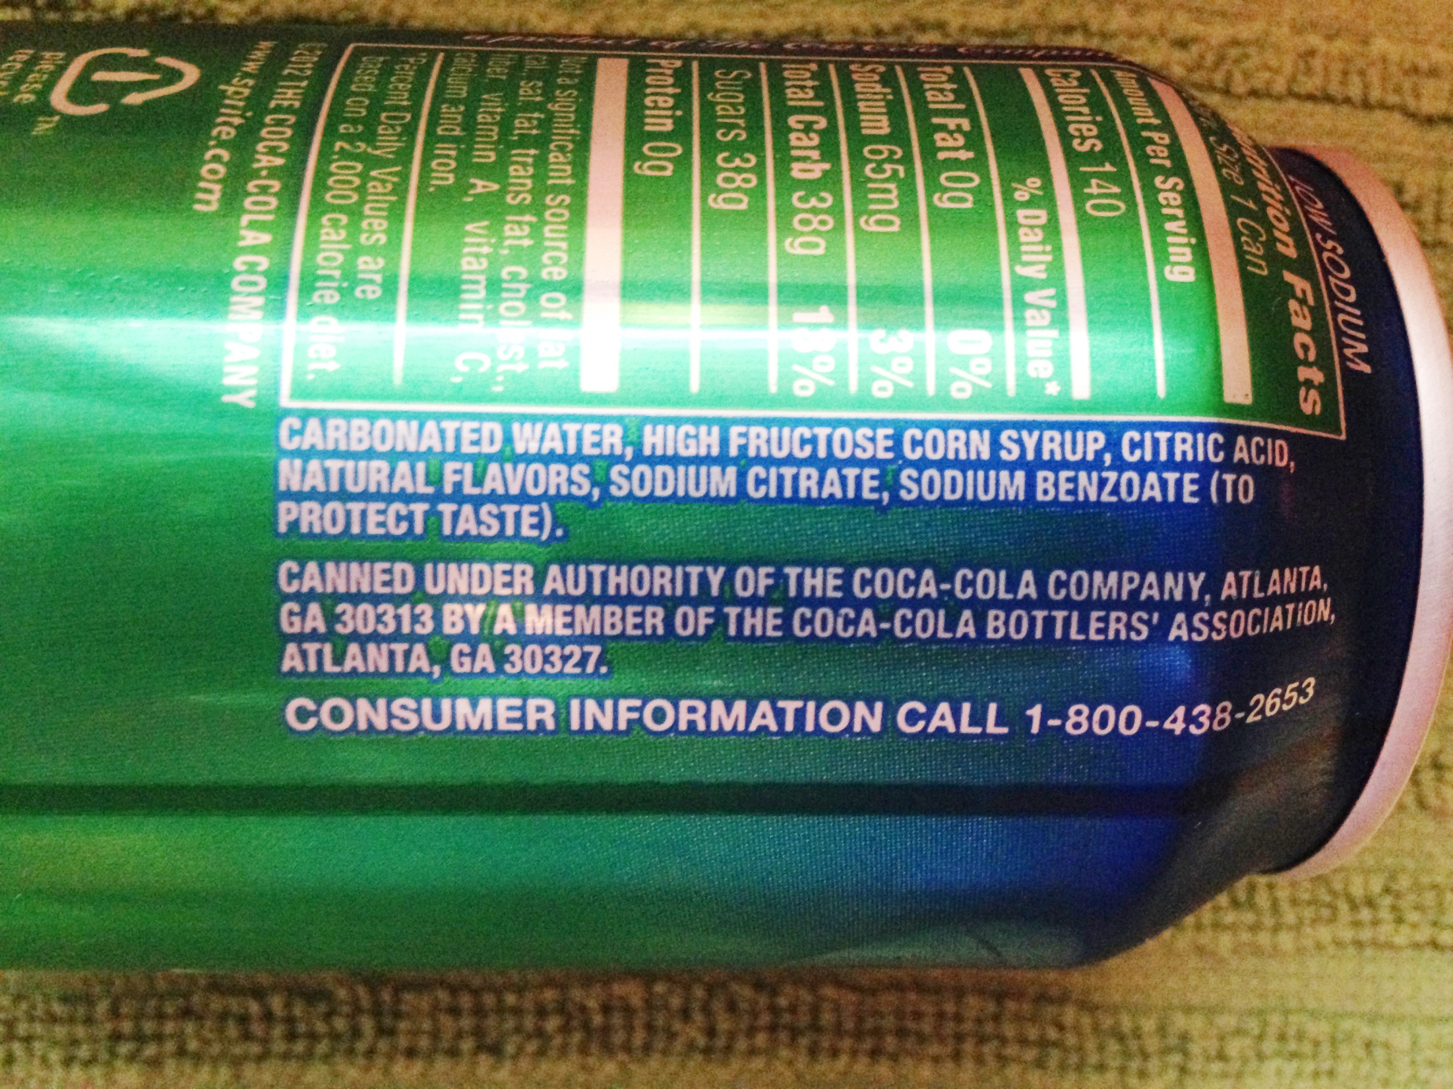

Slide 21
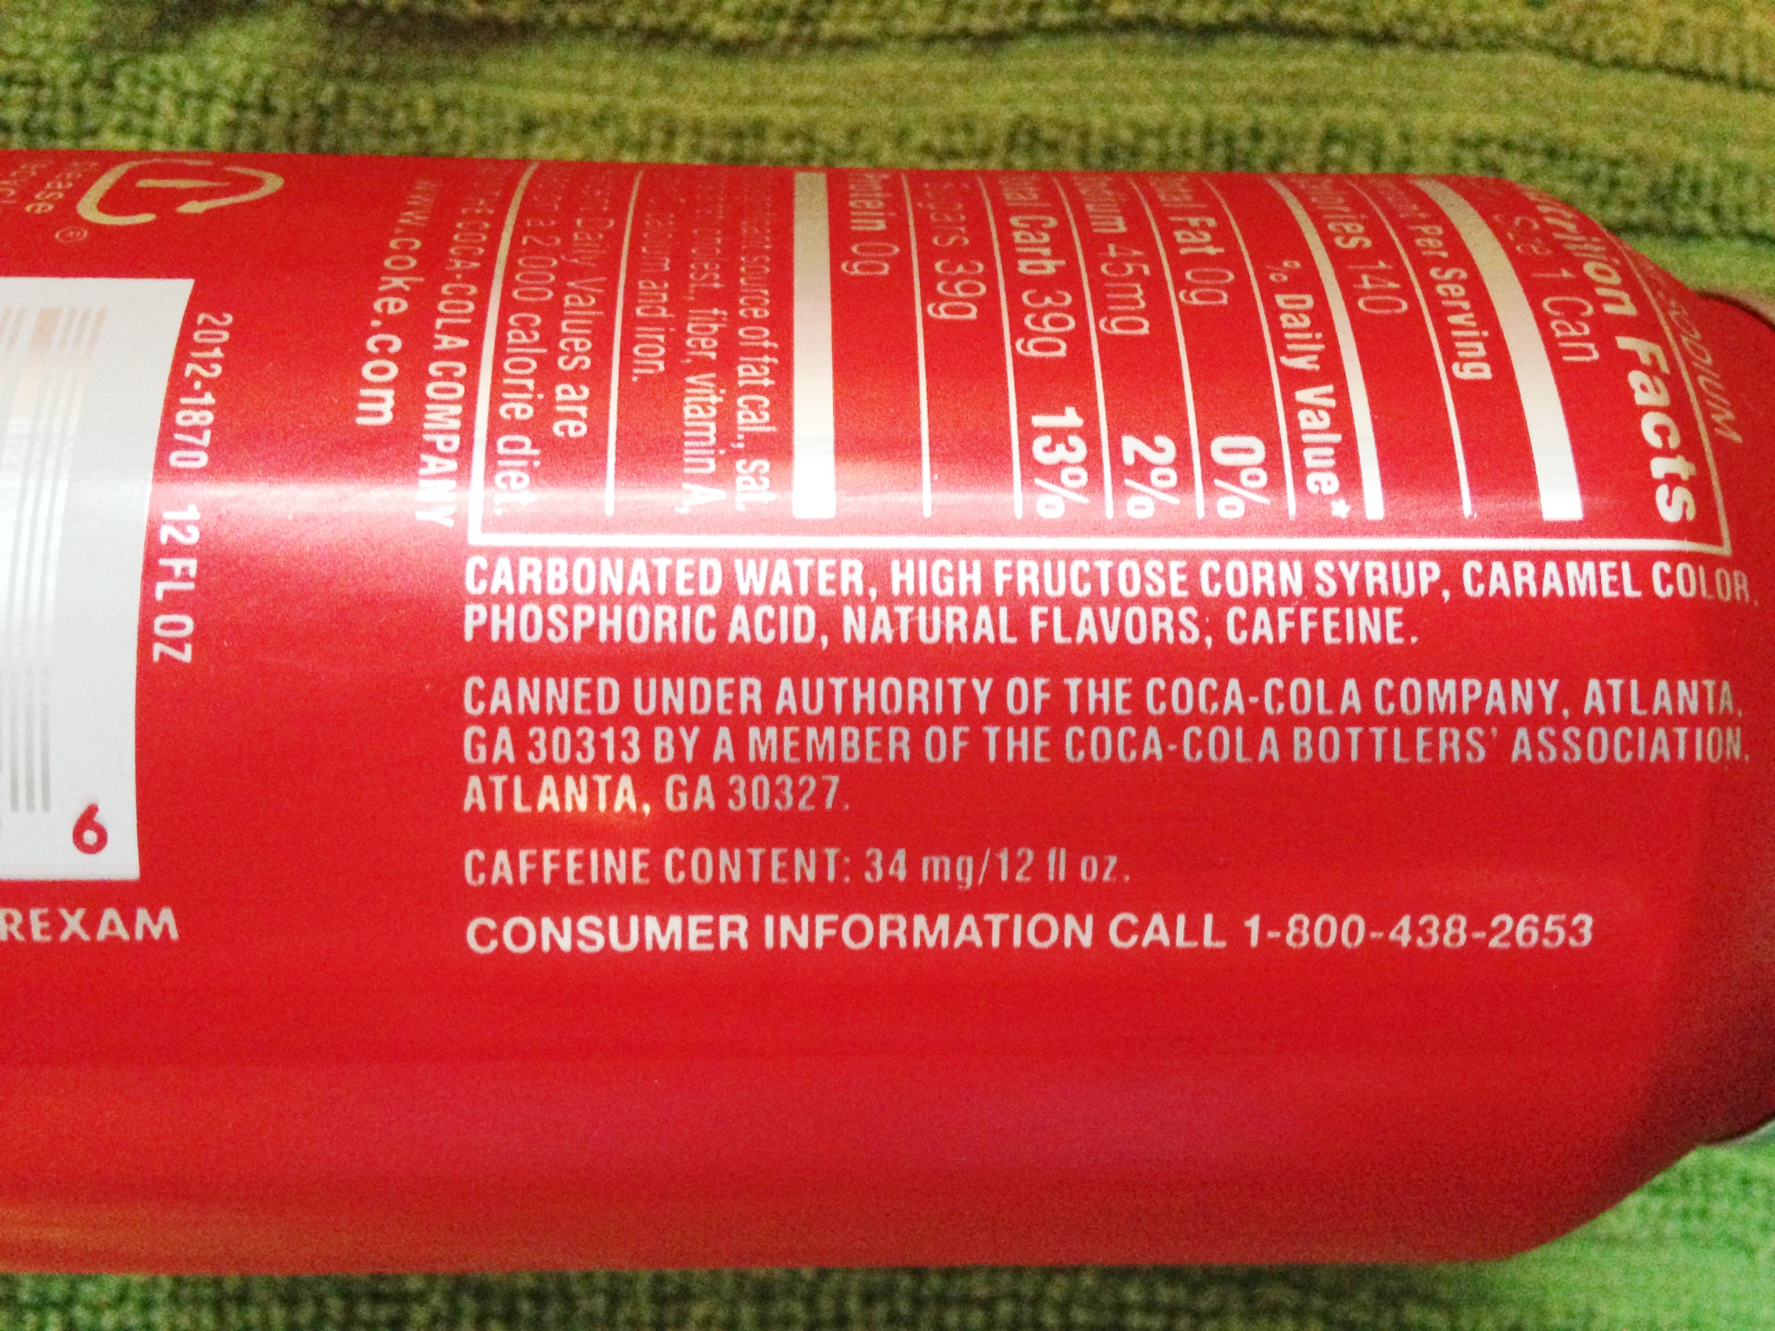

Slide 22
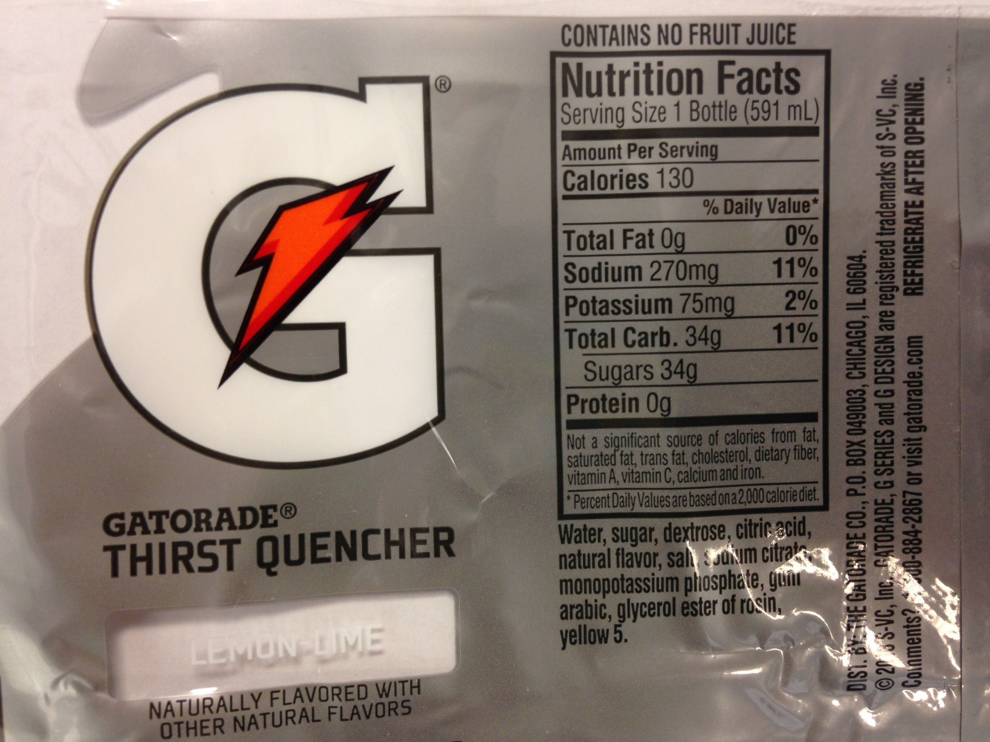

Slide 23
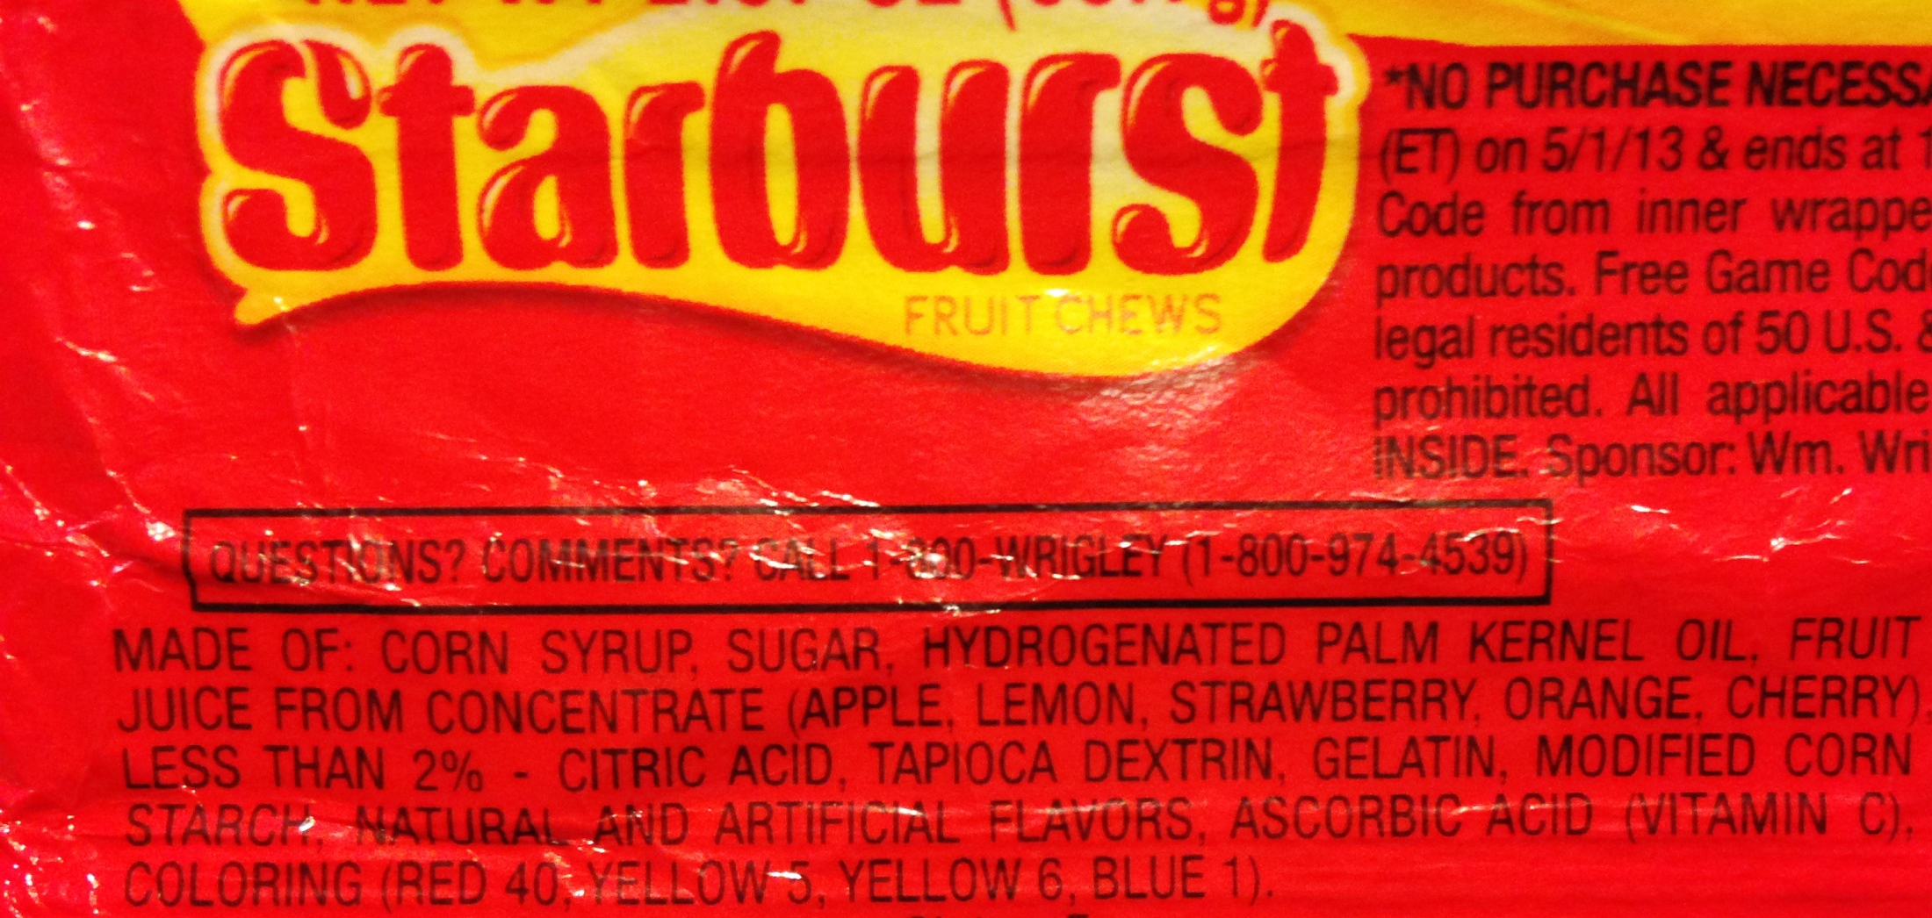

Slide 24
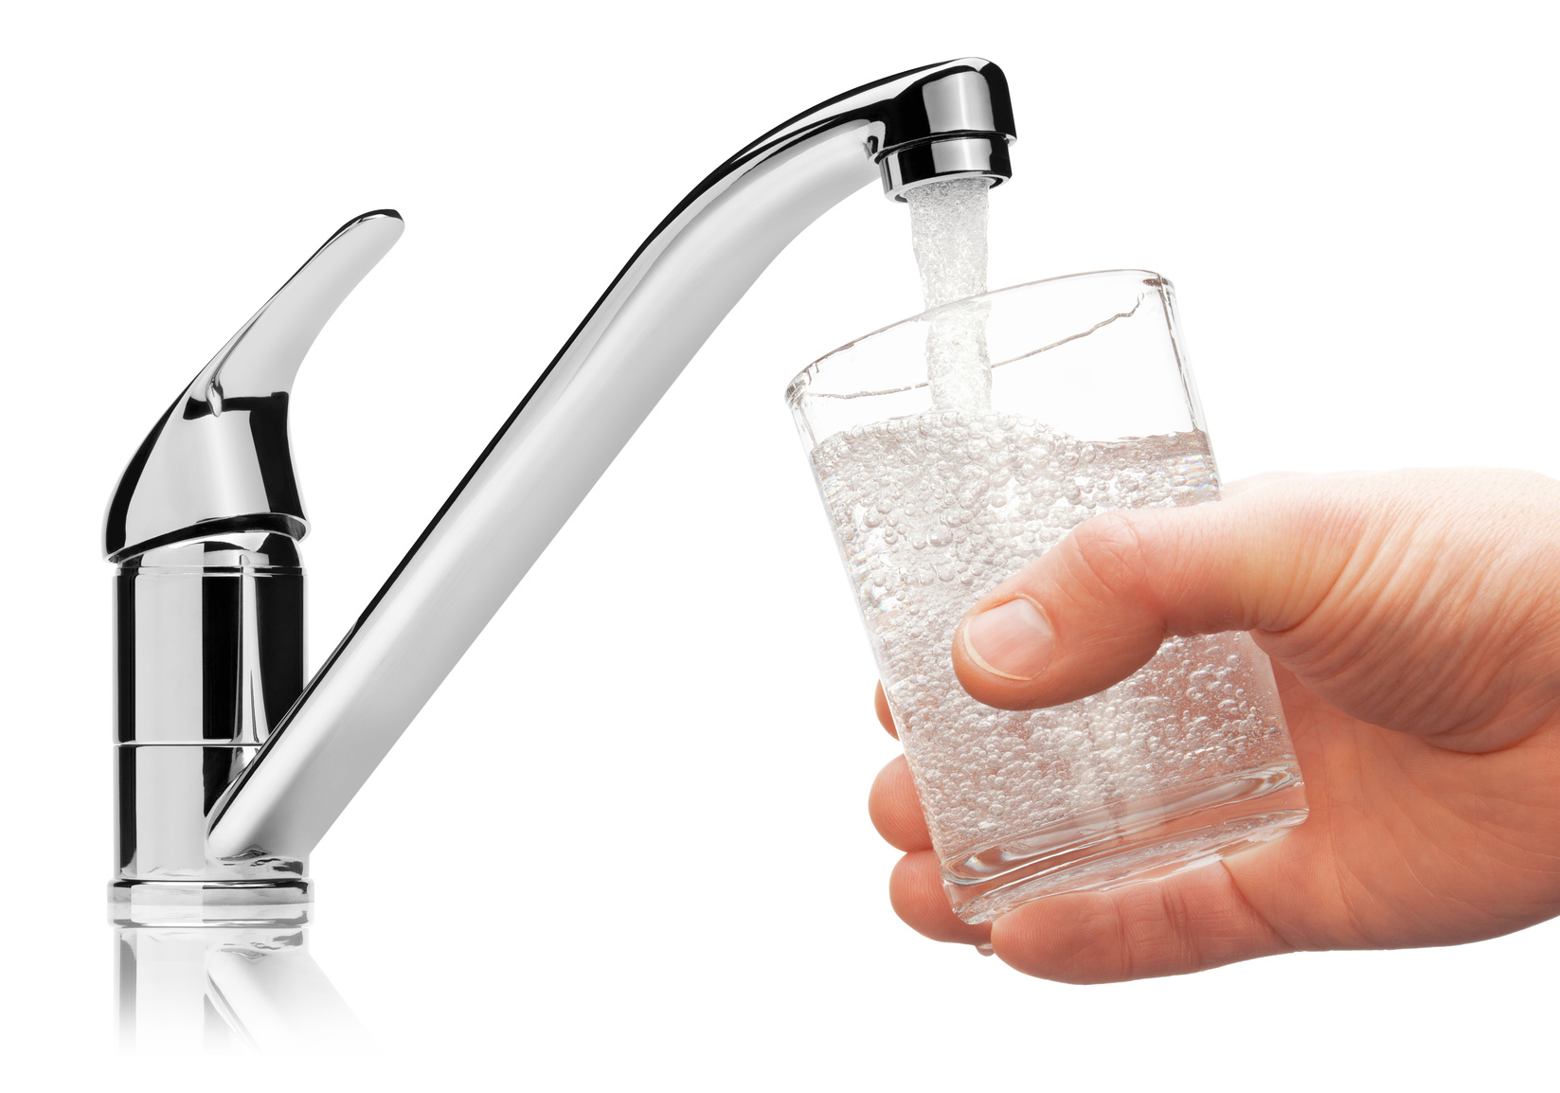
Water
pH = 7
Neutral
Notes:
Perhaps in some your science classes you’ve learned about or will be learning about acids and bases.

Slide 25
Battery Acid pH= 1
Acidic
Notes:
Battery acid is just that – an acid. It’s acid level is 1.

Slide 26
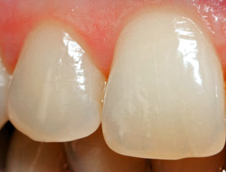
Loss of tooth enamel pH= 4
Notes:
And the loss of tooth enamel starts to occur when there is a pH of 4.
Now I know most of you are saying “Like I am going to drink battery acid” … but it’s not the only thing with a low pH, as we’ll see with these next charts show the pH in candies and soft drinks.

Slide 27
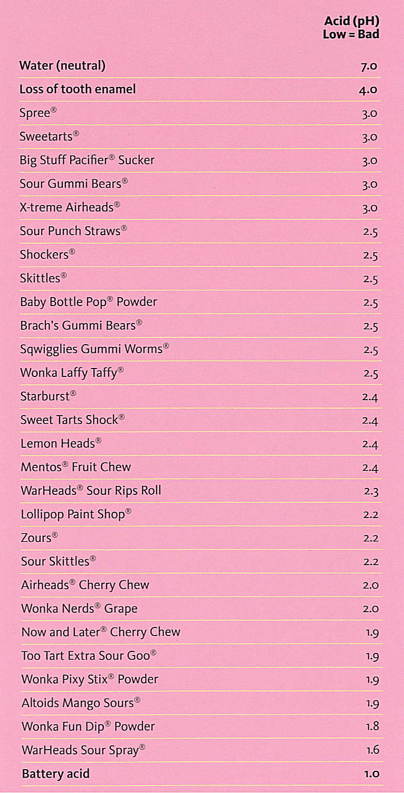
Notes:
Acid levels in popular candies

Slide 28
Notes:
Acid levels in popular soft drinks

Slide 29
What’s the BIG DEAL? Cavities!
Notes:
Remember, acid in drinks and some candy can cause dental erosion. When consumed frequently, this acid can soften the protective enamel which dissolves then exposes the second layer of tooth. The sugar in the drinks and candy feeds bacteria in the mouth which can cause decay. Bacteria have a much easier time eating through soft enamel.

Slide 30
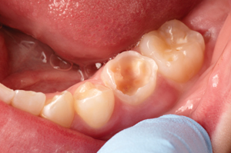
Notes:
This is an actual image provided by a dentist showing a child’s mouth that constantly sucked on hard, sour candies and the decay that occurred.

Slide 31
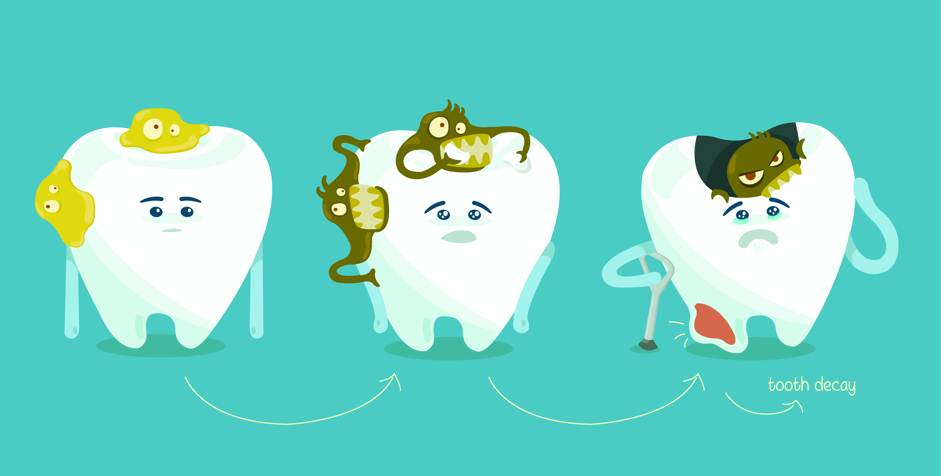
Notes:
This slide shows a great illustration of bacteria on your teeth.

Slide 32
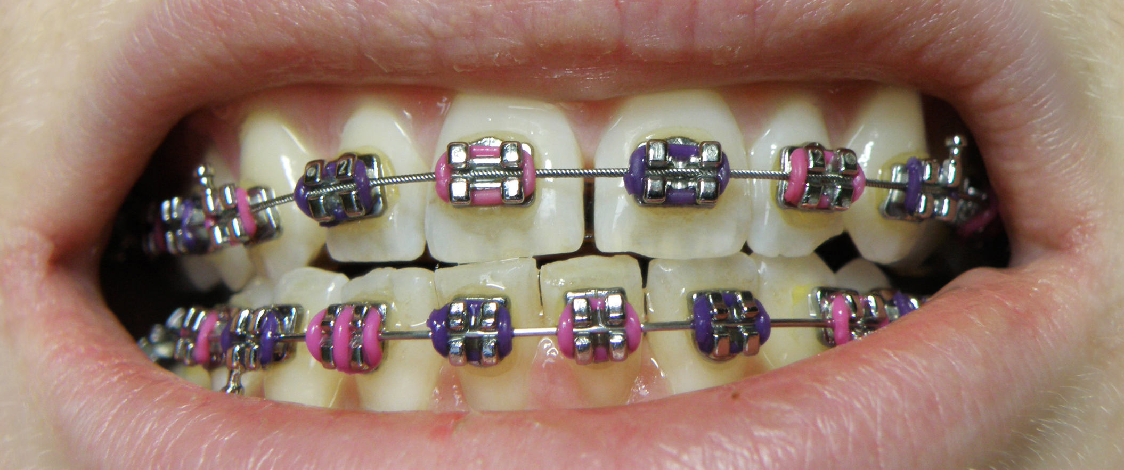
Notes:
Many of you, too, may have braces or be getting those.

Slide 33
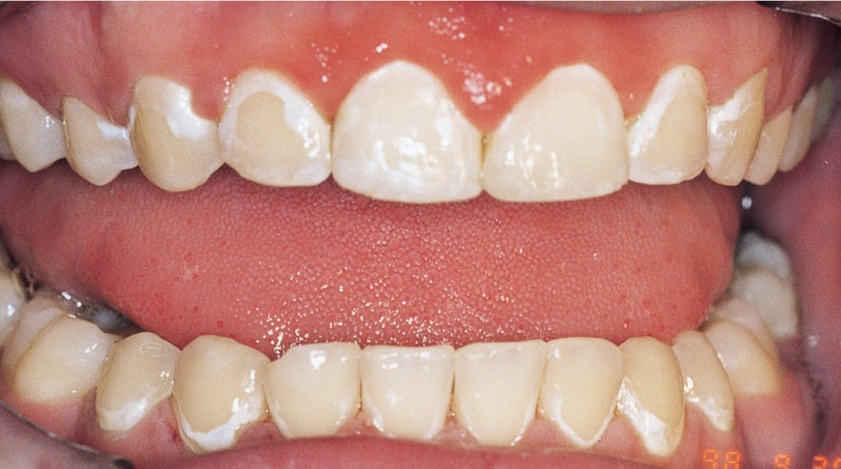
Notes:
You can see on this slide teeth that were not brushed well by a teen who consumed high sugar and acid foods. The white areas are called “decalcification” which is a fancy word for the enamel being “eaten” off the teeth.

Slide 34
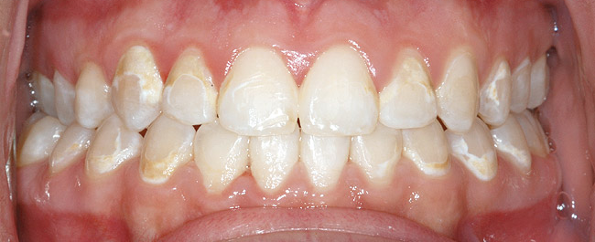
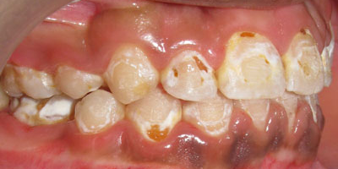
Notes:
The same can be seen on these images, also braces wearers. You can see more brown on the teeth.
This shows that decay may not show in a big hole in your teeth but can happen along the gums and appear as white and brown discoloration – which still is a form of decay.

Slide 35
What’s Added Sugar?
Added sugar is any kind of sugar, added during food processing or by the consumer at the point of consumption.
Added sugars to consider are high-fructose corn syrup, sucrose, corn syrup, corn sugar, dextrose and crystalline fructose.
One way to tell if your food contains these sugars is to look at the ingredients listed on the food label.

Slide 36
Why Added Sugar Is Bad!
Besides potential dental problems …
Weight gain
Replaces good nutrition choices
Possible long term consequences … increased risk of heart attack and stroke earlier in life
What many kids get = 28 teaspoons PER DAY!
What kids are supposed to get = NO MORE than 5 to 8 teaspoons added sugar per day

Slide 37
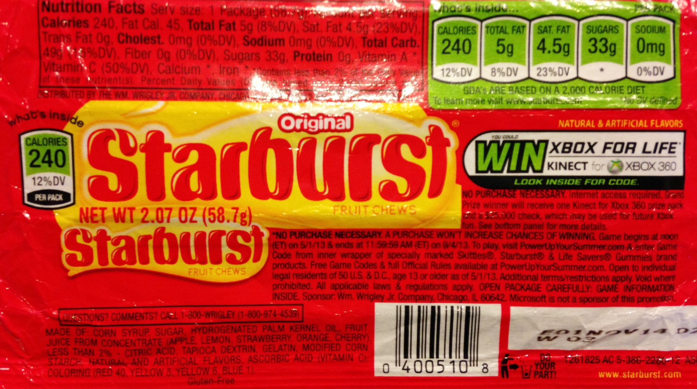
YIKES!
Notes:
No more than 5-8 teaspoons a day? This label shows just how much added sugar is in just one type of candy!
Remember all the soft drink labels we looked at and the high fructose corn syrup? Remember too, there is much added sugar in products we have not discussed today, like snack cakes, cookies and many other products.

Slide 38
Notes:
This slide shows how much exercise has to be done to burn off those extra calories from added sugar. When consumers were shown this, they had better habits and choices.

Slide 39
Notes:
Why are we telling you all this now? Aren’t you young enough it doesn’t matter? Or maybe you think you’ll care more when you become an adult?
Historically, beverage (and some food) preferences are set in adolescence, the first time that most people begin choosing and buying a favorite brand.
Kids these days are growing up with all of these other options (bottled waters, juices).
If kids grow up without carbonated soft drinks, the likelihood that they are going to grow up and, when they are 35, start drinking is very low.
If you get educated about healthy choices now, this education will stay with you in the future.

Slide 40
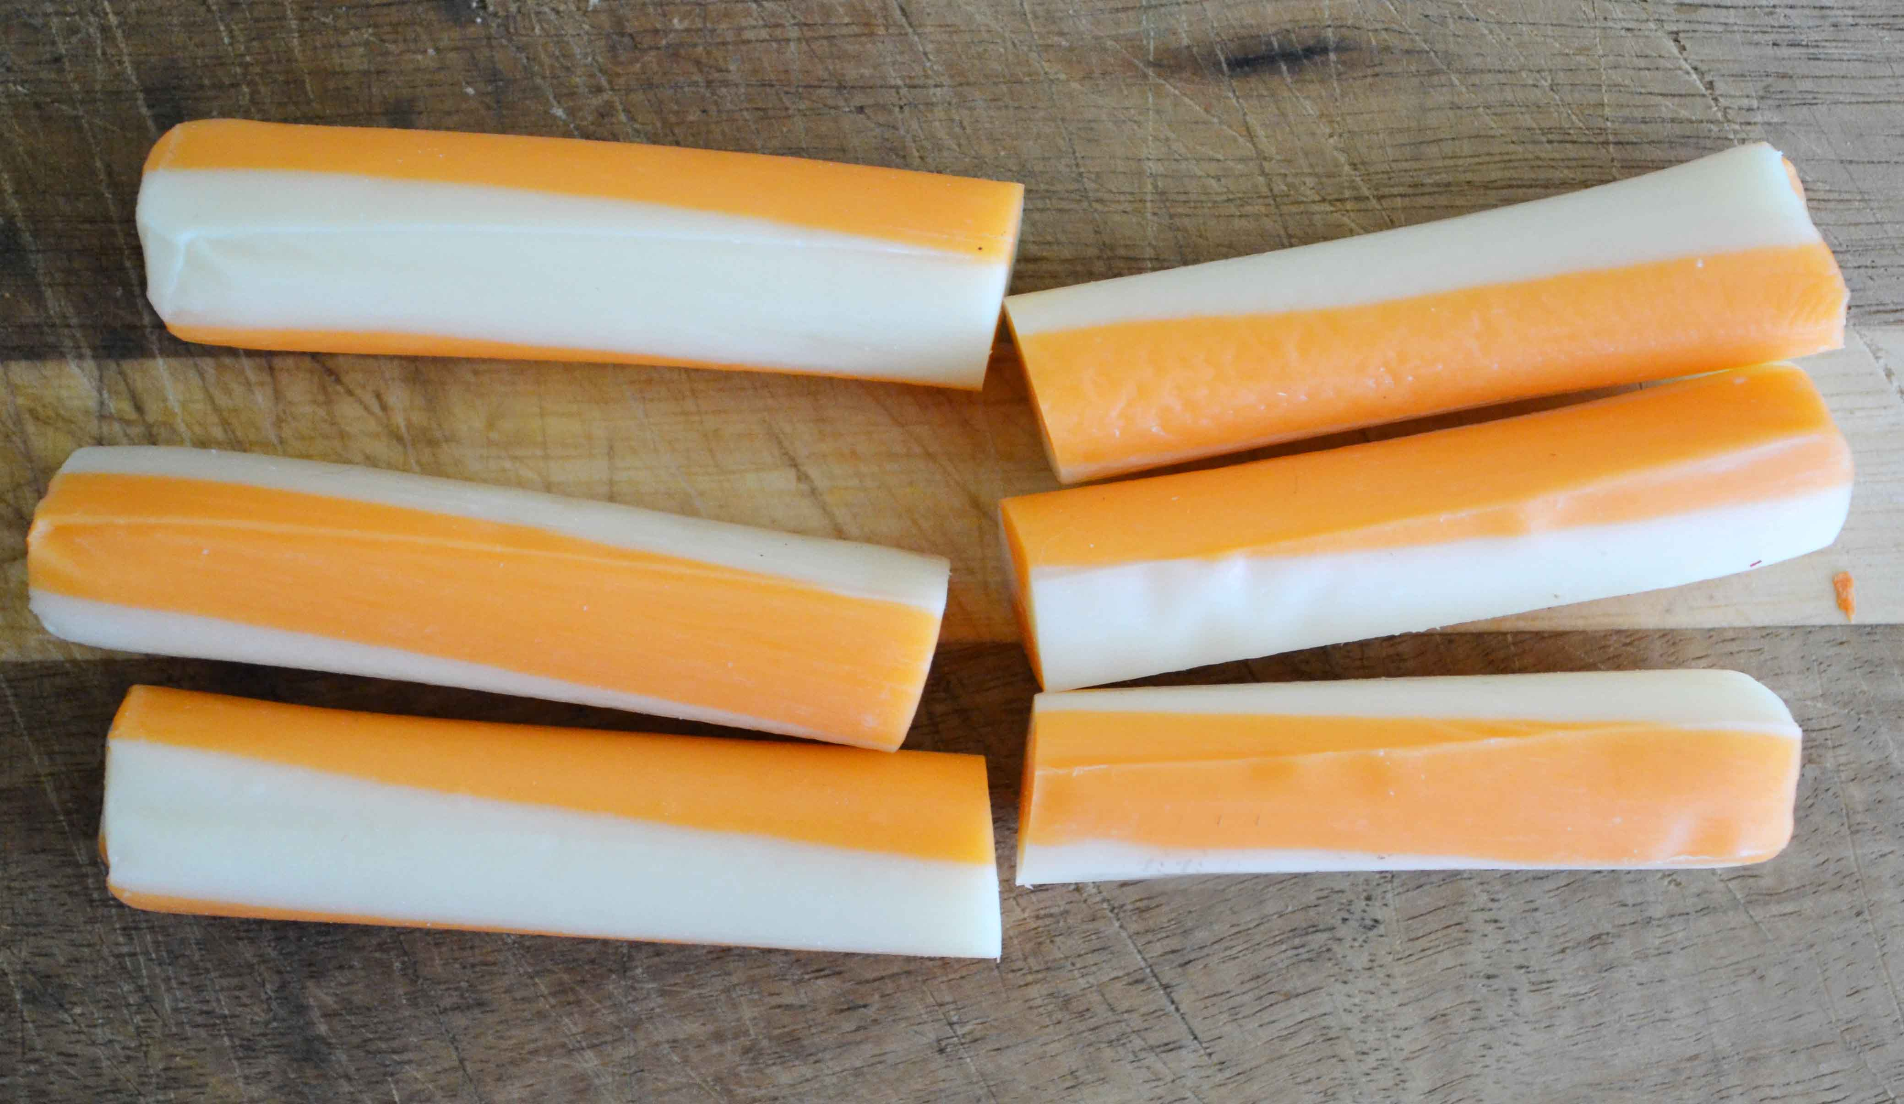
Notes:
What can you eat that is better?
Show better food and drink choices and discuss that not only do these not have the high amount of sugar and acid, but they also contain nutrients that help you grow.

Slide 41
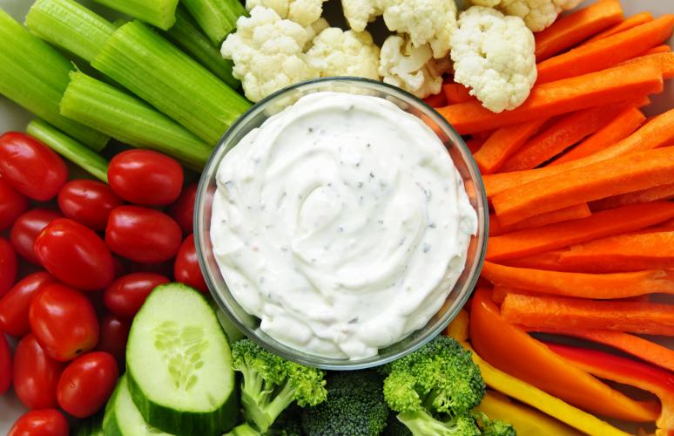

Slide 42
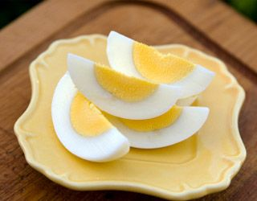
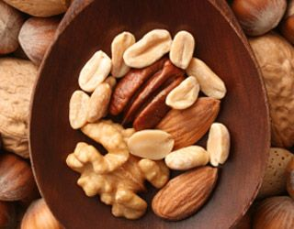
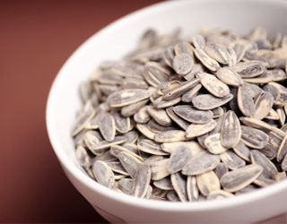

Slide 43
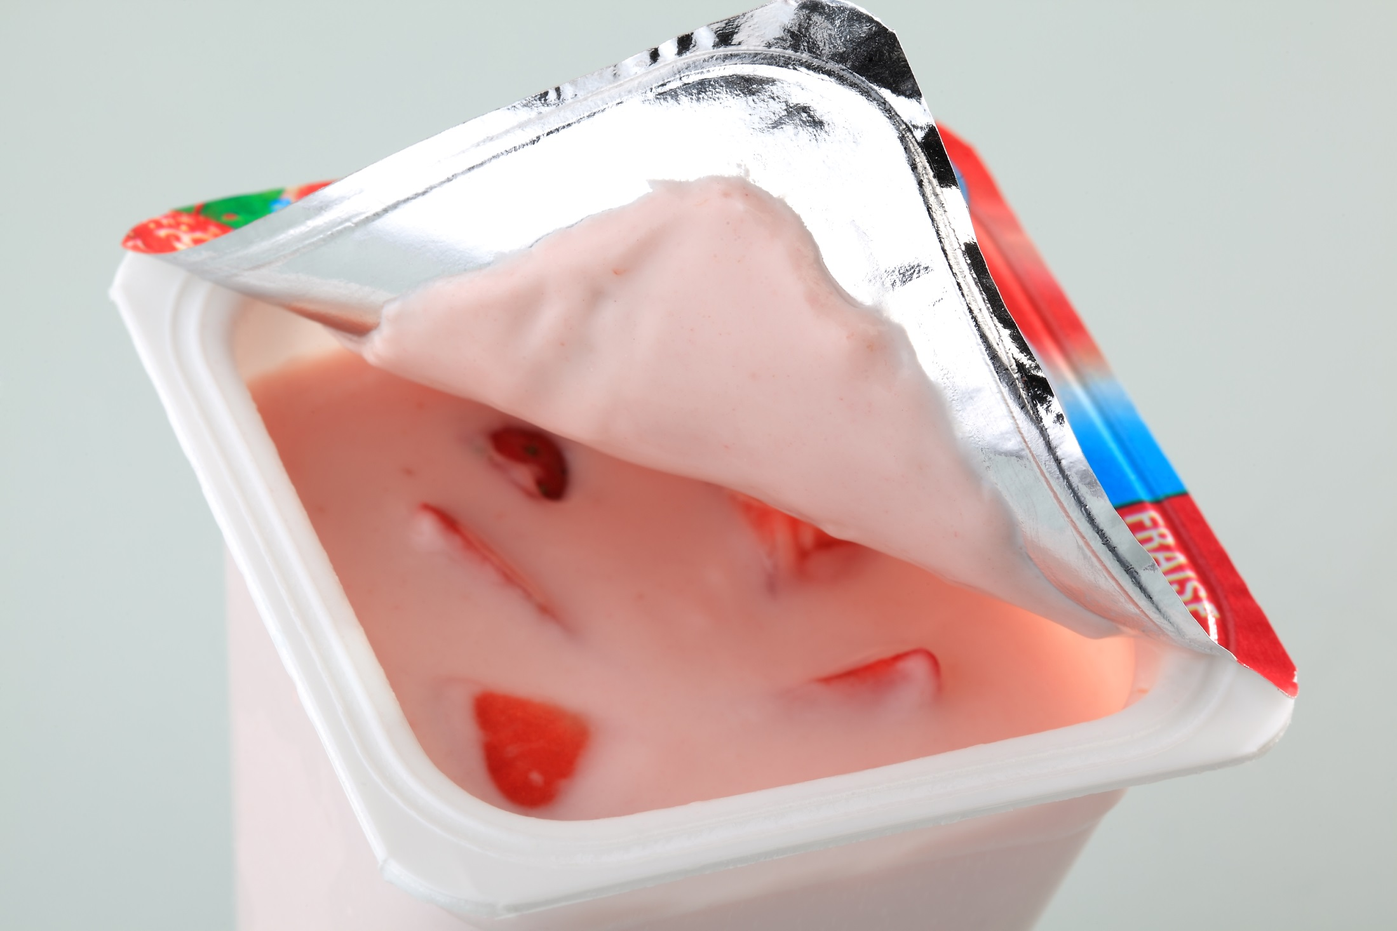
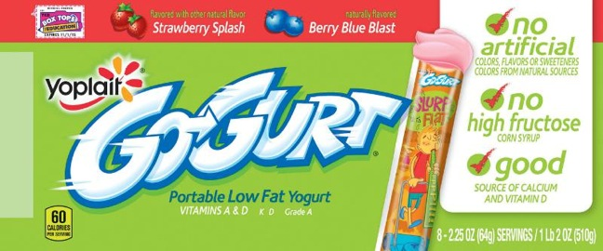

Slide 44
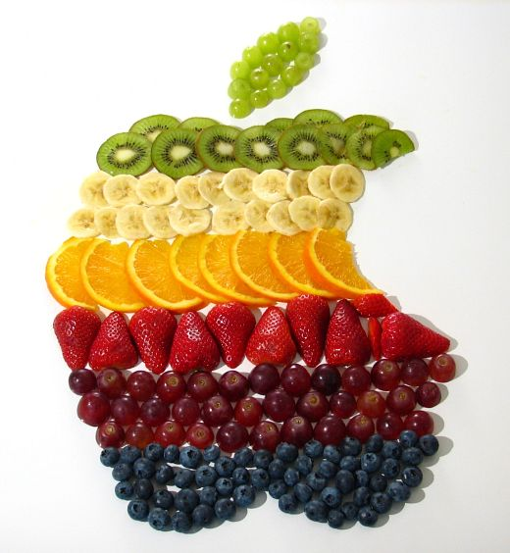
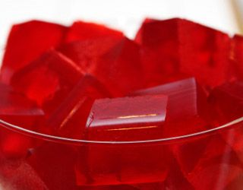
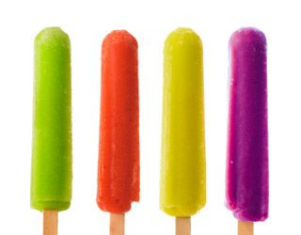

Slide 46
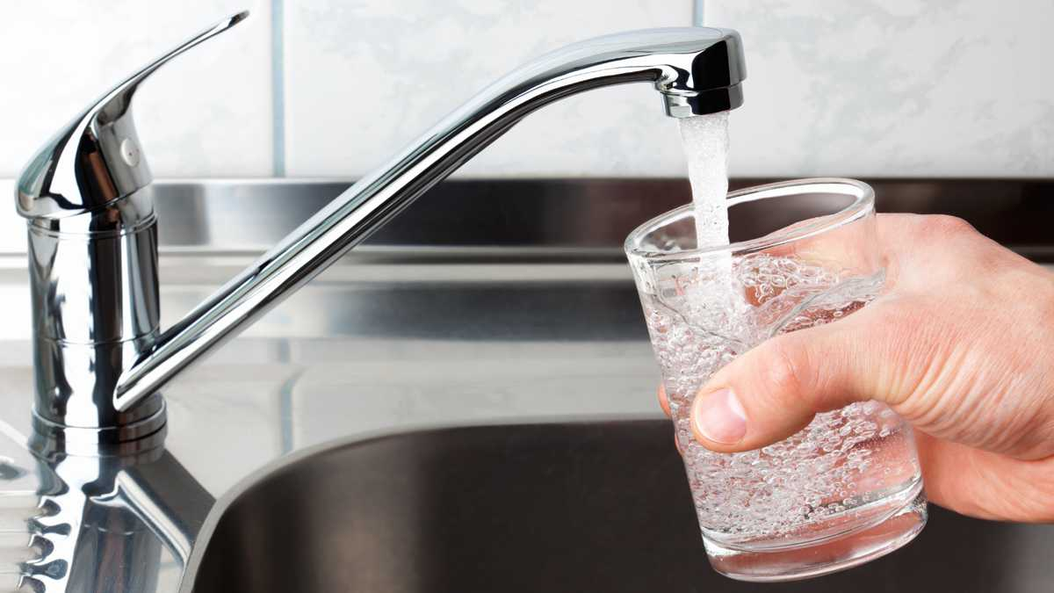

Slide 47
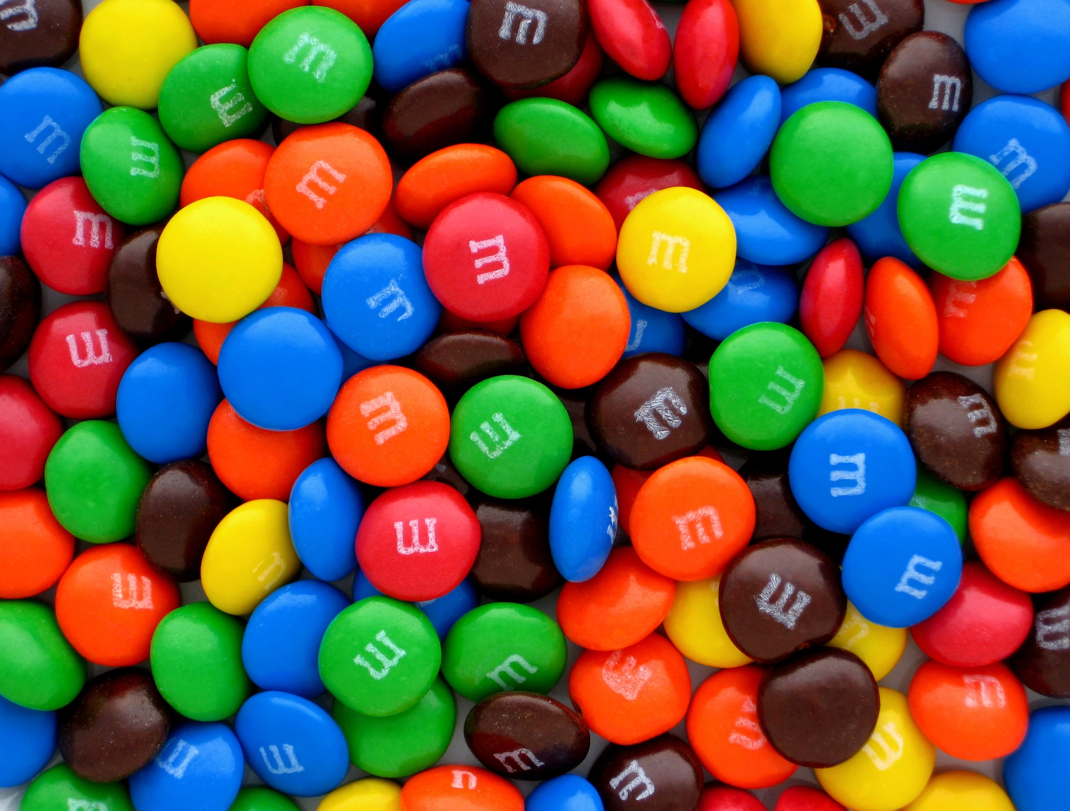
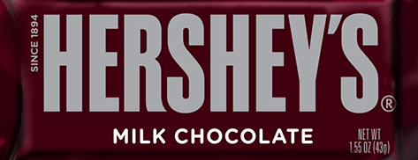
Still not great … but washes off teeth faster and not so much acid!
Notes:
I’m not saying you can’t ever have candy as a treat … but it should be just that, a treat—not something you should have every day.
And, if you do have candy, something like chocolate that melts and washed off your teeth easier and doesn’t get stuck (or is something you can suck on for a long time) is better than other candy choices.
Also, when you do have candy, it’s a good idea to rinse with water after you finish eating it. Example of eating chocolate is better because it doesn’t STICK to your teeth and between your teeth.

Slide 48
Prevention (Defense)
Notes:
Back to our football analogy … OK, so you’ve had some candy and soda. Now what?
Make sure you are brushing and flossing at least 2min2X each day to remove all that gunk from your teeth!

Slide 49
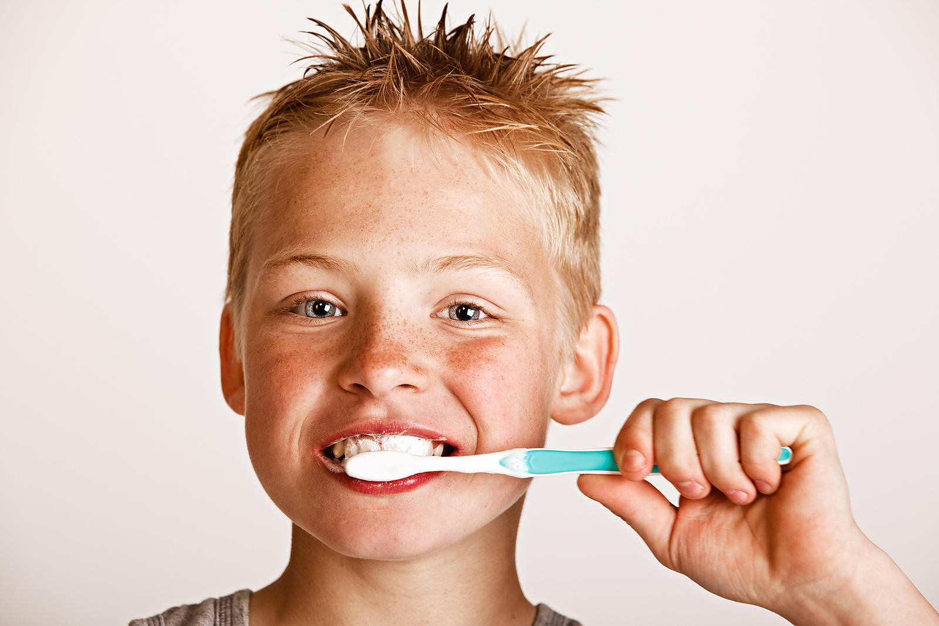
Brush for 2 Minutes, 2 Times Day
2Min2X

Slide 50
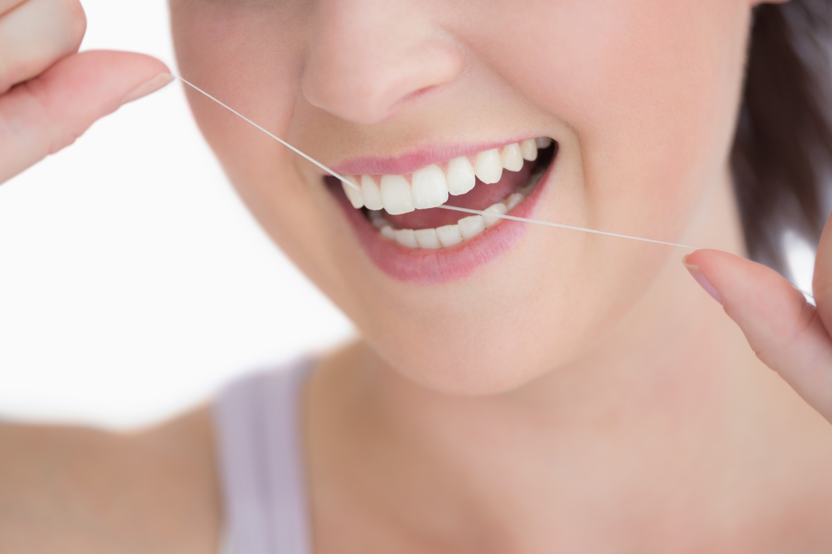
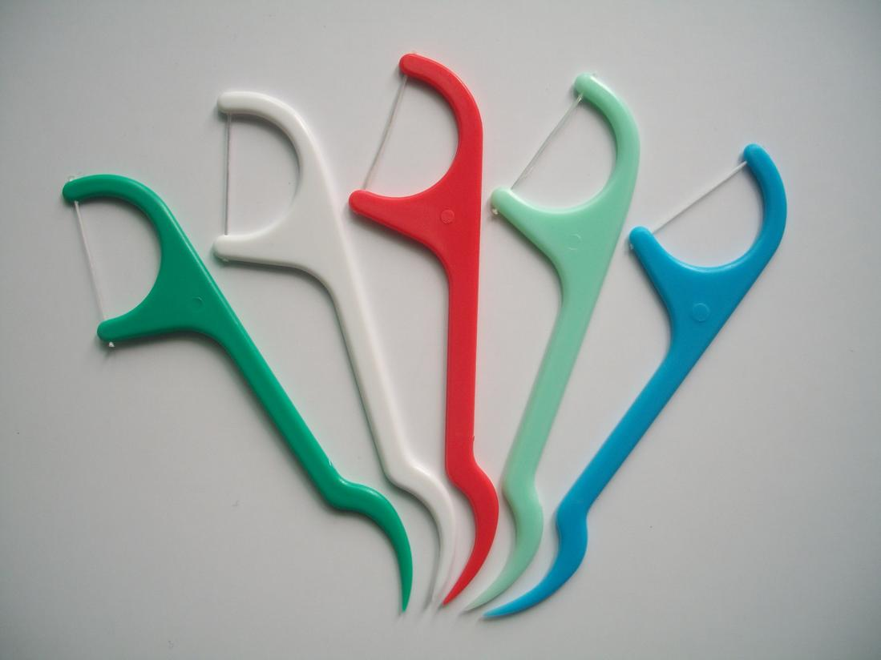
Floss … At Least 3 Times Each Week
Notes:
Flossing
Daily is great, but even if they did EVERY other day or even 3 times a week, that would be awesome (M, W, F)!
We know too it may be easier for youth to use floss picks rather than actual floss

Slide 51
Notes:
Close with Take Away Points …
A healthy mouth is part of a healthy body.
Choose Healthy Foods and Drinks
Limit candy and soda
Choose healthy snacks and fruit for something sweet
Brushing and Flossing
Stress 2Min2X Day
Try to floss 3 times each week

